Slide 1
The New Deal

Slide 2
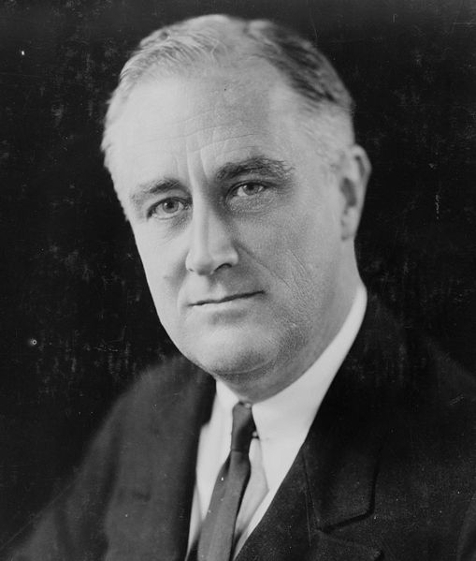
Electing FDR
Franklin Delano Roosevelt
Beats Hoover in the 1932 election in a landslide
Americans place all their hope in FDR to cure unemployment and poverty

Slide 3
Waiting For Roosevelt to Take Over
After the election in November:
Americans had to wait four months for FDR to take over
The 20th amendment was not ratified until 1933
Stated that Presidents were to be inaugurated in January
FDR had to wait until March to become President.

Slide 4
The New Deal
The New Deal
Roosevelt's program designed to alleviate the Great Depression.
Focused on three general goals:
Relief for the needy
Economic Recovery
Financial Reform

Slide 5
The Hundred Days
“Hundred Days”
The first hundred days of the Roosevelt administration
Congress passes 15 new pieces of Legislation
Most of the new laws expanded the power of the Federal Government
Roosevelt’s first act as President was bank reform.

Slide 6
An Important Fireside Chat
Fireside Chats
A set of presidential addresses given by FDR intended to make Americans feel as if he were speaking to them personally.
His 1st fireside chat was aimed at convincing Americans to keep their money in banks.

Slide 7
Regulating Banking and Finance
Glass-Steagall Act
Established the Federal Deposit Insurance Corporation
Provided banking insurance for accounts up to $5,000
Federal Securities Act
Required corporations to provide complete information on all stock offerings.
Congress creates the SEC (Securities and Exchange Commission)
Established to regulate the stock market

Slide 8
Rural Assistance
Agricultural Adjustment Act
Intended to raise crop prices by lowering production
The federal government paid farmers over $200 million to plow under cotton crops and slaughter 6 million pigs.
Many Americans were mad that the government was wasting food when so many were starving to death.

Slide 9
Providing Work Projects
Civilian Conservation Corps
Put young men aged 18-25 to work
Building roads, developing parks, planting trees etc…
National Industrial Recovery Act
Gave money to states to create jobs in construction

Slide 10
Food, Clothing and Shelter
Many new governmental policies provided for food, clothing and shelter.
Home Owner’s Loan Corporation (HOLC)
Provided governmental funding to home owners to prevent foreclosures.
Federal Emergency Relief Administration (FERA)
$500,000,000 provided by the government for the needy.

Slide 11
New Deal Comes Under Attack
Roosevelt agreed to deficit spending to try to end the Great Depression.
Deficit Spending- Government spending more money than is coming in.
Roosevelt’s New Deal did not work to end the Depression and many critics began to come to the forefront.

Slide 12
Opposition to the New Deal
Supreme Court
Ruled the NIRA as unconstitutional
Declared it violated the checks and balance system.
Struck down the AAA
Declared agriculture should be regulated by states and not the federal government.

Slide 13
Three Fiery Critics
Father Charles Coughlin
Roman Catholic Priest
Famous radio show that opposed FDR and the New Deal
Dr. Francis Townsend
Physician in Long Beach California
Argued that Roosevelt was not doing enough to help the poor and elderly
Senator Huey Long
Originally supported the New Deal
Proposed a nation-wide social program called “Share our Wealth”

Slide 14
The Second New Deal

Slide 15
Overview
After the first “New Deal”:
The economy had not significantly turned around
Unemployment was still extremely high
His programs established during the 1st new deal had not worked the way FDR intended.

Slide 16
The Second Hundred Days
The 2nd New Deal
Called for more extensive relief for farmers and workers.
Eleanor Roosevelt
FDR’s wife
Humanitarian
Traveled the country trying to provide relief for suffering Americans

Slide 17
Reelecting FDR
1936 Presidential Election
The 2nd New Deal was under way
FDR won again in a landslide
1st election in history where the majority of African Americans voted democrat.

Slide 18
Helping Farmers
Focusing on the Farms
When the Supreme Court shot down the (AAA) in 1936, Congress passed another law to replace it:
Soil Conservation and Domestic Allotment Act
Paid farmers for cutting production and practicing soil conservation methods.

Slide 19
Helping Farmers Continued
The 2nd AAA
Congress passes the 2nd AAA
The supreme court approved this AAA (the processing tax to pay for farm subsidies was removed)
Farm Security Administration
Est. 1937
Loaned more than 1 billion to help tenant farmers and migrant workers.

Slide 20
Roosevelt Extends Relief
Works Progress Administration (WPA)
Established to help young men and professionals find work.
Run by Harry Hopkins
Between 1935 and 1943
Spent $11 billion to give jobs to more than 8 million.

Slide 21
WPA and NYA
WPA Workers Built
850 airports
Constructed and repaired 651,000 miles of roads
125,000 new public buildings
National Youth Administration (NYA)
Provided jobs, education, counseling and recreation for young people.
Provided student aid for high school and college graduates.

Slide 22
Improving Labor Conditions
Wagner Act (National Labor Relations Board)
One of the first reforms of the 2nd New Deal
Sponsored by Senator Robert Wagner of NY
Est. that the federal government would protect the rights of workers to join labor unions.
Prohibited unfair labor practices
(Threatening workers, firing union members)

Slide 23
Social Security Act
Social Security
Three major parts to the Act
Old-age insurance for retirees 65 or older and their spouses
Unemployment Compensation System
Aid to families with dependent children and the disabled

Slide 24
Expanding Utilities
1935
Only 12.6% of Americas farms had electricity
Roosevelt establishes Rural Electrification Administration (REA)
Financed and brought electricity to isolated areas.
90 percent of American homes had electricity by 1940.

Slide 25
The New Deal Affects Many Groups

Slide 26
The New Deal Brings New Opportunities
Women Make Their Mark
Francis Perkins
1st ever female cabinet member (Secretary of Labor)
Eleanor Roosevelt
Helped her husband gain the support of many women voters.
However women still faced discrimination
A poll taken in 1936 showed that 80% of Americans felt women should not work if their husbands had a job.
People thought women were taking jobs away from the men.

Slide 27
African American Activism
During FDR’s administration over 100 African Americans were appointed to high-ranking government positions.
Mary McLeod Bethune
Educator
Dedicated to promoting opportunities for young African Americans

Slide 28
FDR Fails to Support Civil Rights
FDR Never fully supported civil rights for African Americans
Did not want to upset white, southern democrats.
Refused to sign anti-lynching bills
Many of the new deal policies discriminated against African Americans

Slide 29
Mexican-American Fortunes
Mexican Americans
Generally supported the New Deal
Received even lower wages and treatment than African Americans
Made about 9 cents an hour

Slide 30
Native Americans Gain Support
Natives
Received strong support from the New Deal
FDR appointed John Collier as commissioner of Indian Affairs
Created Indian Reorganization Act of 1934.

Slide 31
Indian Reorganization Act of 1934
IRA of ’34
Moved for autonomy and not assimilation of African Americans
Economic- Native American Lands would belong to the entire tribe.
Cultural- Children could attend school on the reservation.
Political- Given permission to elect tribal councils

Slide 32
FDR Creates the New Deal Coalition
New Deal Coalition
An alignment of diverse groups that supported the democratic party.
Included
African Americans
Southern Whites
Various Urban groups

Slide 33
Labor Union Flourish
Union conditions
Better wages
Shorter days
Increased bargaining power
Unions contributed campaign funds to FDR because he supported their rights.

Slide 34
Labor Unions
Between 1933-1941
Union membership grew from 3 million to 10 million
Major Union Tactic
Sit Down Strikes
Instead of leaving their jobs, they would stay inside the plants and sit down on the factory floor.

