Slide 1
The First World War

Slide 2
Causes of World War I
Four long-term causes of the First World War
Nationalism
Imperialism
Militarism
System of Alliances

Slide 3
Nationalism
In the 19th century politics in the western world were deeply influenced by nationalism.
  Devotion to the interest and culture of one’s nation
  Nationalism led to rivalries between nations

Slide 4
Imperialism
As European countries built empires, they fought for control over the colonies that produced raw materials.
  Ex. France and England began a struggle against Germany for different territories.

Slide 5
Militarism
No nation wanted to have an enemy that had a stronger military than they possessed.
  Militarism
    The development of armed forces and their use as a tool of diplomacy.
    The country with the most “guns” was the most powerful.

Slide 6
System of Alliances
Two major alliance groups in Europe
  Allies
    France
    Britain
    Russia
  Central Powers
    Germany
    Austria-Hungary
    Italy

Slide 7
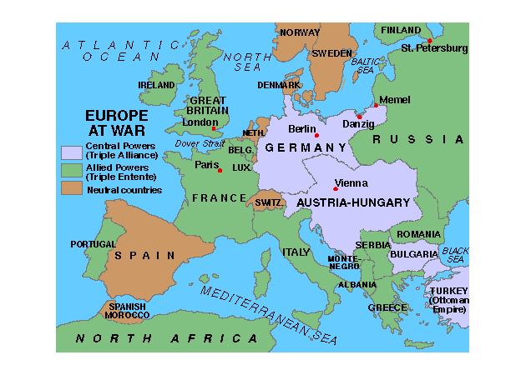
MAP OF EUROPE

Slide 8
Assassination Leads to War
Russia, Germany and Austria Hungary all want access to the Balkan Peninsula.
1914
  Archduke Frans Ferdinand (Heir to the Austrian throne) visits Bosnia, Sarajevo
  Gavrio Princip, a member of a nationalist group called “Black Hand” shot and killed the Archduke and his wife.

Slide 9
The Result
Austria declares war on Serbia on July, 28
  August 1- As a result of Alliances, Germany declares war on Russia
  August 3- Germany Declares war on Russia’s ally France
  After the Germans invade Belgium, England declares war on Austria Hungary and Germany.

Slide 10
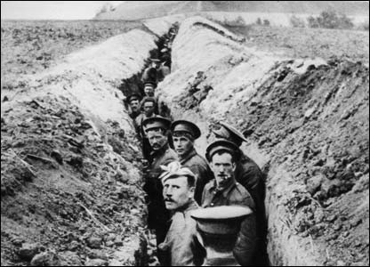
Trench Warfare
Spring 1915
  Trench warfare begins
      2 Parallel sets of trenches
      Germans occupied one side
      Allies occupied the other
      (1.2 Million Deaths as a result of trench warfare)

Slide 11
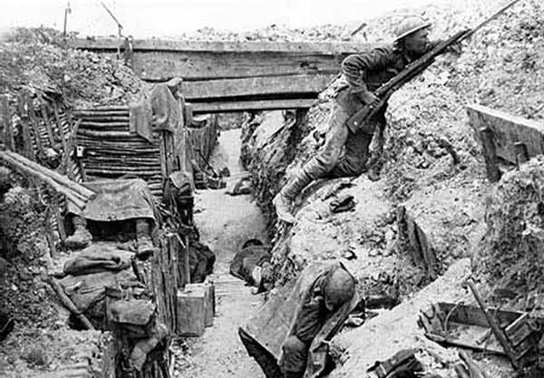
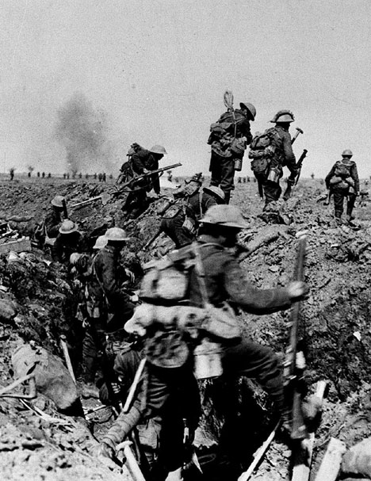
Trench Warfare

Slide 12
America wants to stay neutral
Naturalized Citizens
  Felt a sense of loyalty to the countries they came from
Socialists
  Thought the war was over capitalist fighting over profitable territories
Pacifists
  Did not believe in war
Parents
  Did not want their boys to go over seas and fight

Slide 13
British Blockade
The British set up a naval blockade of all German Ports:
  No weapons in or out
  No food in or out (750,000 Germans starved to death).

Slide 14
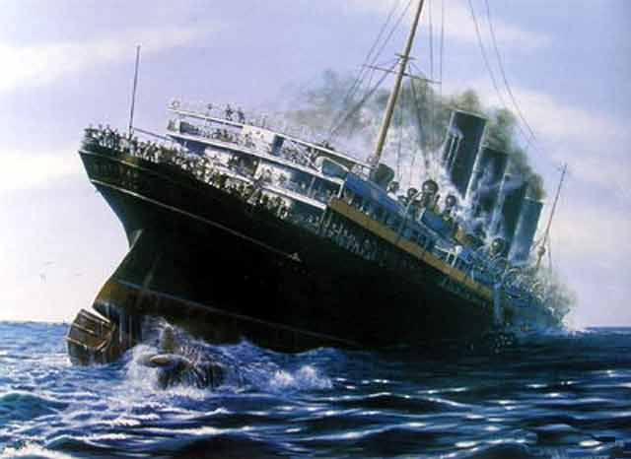
German U-Boat Response
As a response to the blockade, Germans send in the U-Boat (Submarines)
  Any Allied boat off the waters of Britain would be torpedoed

Slide 15
Passenger Boats
Lusitania
  British passenger boat sunk off the coast of Ireland
  1198 civilians killed (128 Americans)
  America is angered by the killing of Americans
  Germans claimed the boat was carrying munitions (Not True)
  The Germans went on to also sink the Arabic and the Sussex breaking a promise with America.

Slide 16
2 Reasons America Enters the War
German Kaiser announces that U boats will sink all ships in British waters (hostile or neutral)
Zimmerman Telegram
  German Telegram intercepted by the British
  Proposed a German Alliance with Mexico
  Germany was going to use Mexico to invade the U.S. (Deal would help Mexico retake Arizona, Texas and New Mexico).

Slide 17
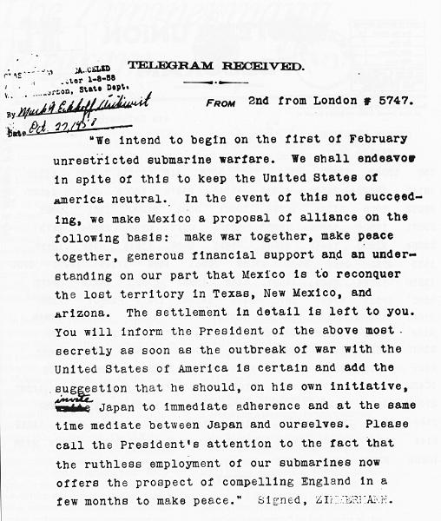

Slide 18
America Acts
April 2, 1917
  President Woodrow Wilson delivers War Resolution.
  America Officially enters the War.

Slide 19
CAUSE AND EFFECT
Using the below prompts to create cause and effect diagrams.
Germany declares war on Russia
Germany declares war on France
England declares war on Germany
America takes a neutral stance
America enters the war

Slide 20
American Power Tips the Balance

Slide 21
Section 1 Recap
Heir to Austria Hungary’s throne, Archduke Frans Ferdinand, assassinated in Bosnia.
Allied powers: England, Russia, France
Central powers: Italy, Germany, Austria Hungary
  Trench Warfare
German u-boats sink the Lusitania (British passenger liner)
America enters the war because of the Zimmerman Telegram.

Slide 22
America Mobilizes
Only 200,000 men in service at the time U.S. enters the war.
To meet the government’s need for more men, congress established the Selective Service Act.
  Required men to register with the government in order to be randomly selected for military service.

Slide 23
YOUR COUNTRY NEEDS YOU!!
In groups of three create a campaign “poster” and slogan designed to inspire the American people to want to enter the war. Things to remember.
    There is a need for many people to join the military forces
    Up to this point many Europeans have died in this war, the fear of the American citizens is that our soldiers will go over and be killed
    You must appeal to the patriotism of the American people in order to successfully gain their support.
Groups will give their campaign slogan in front of the class. You have 20 minutes to complete your slogan and “poster.”

Slide 24
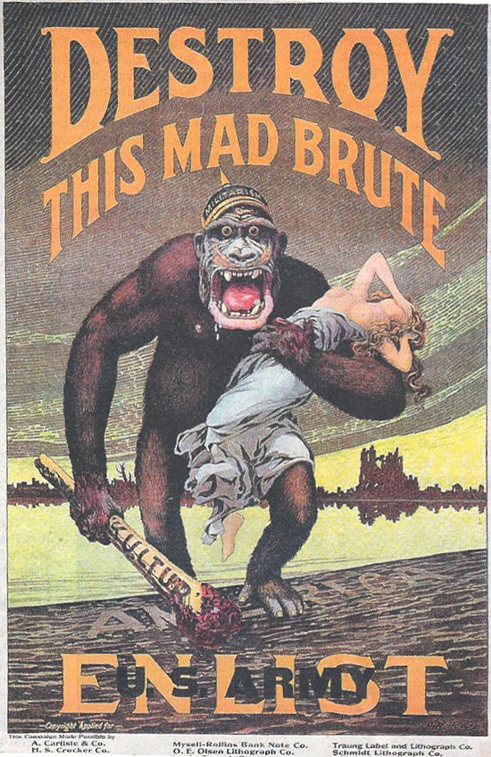
GO ARMY

Slide 25
American Enthusiasm
What America brought to the war.
  Many men for reinforcement
  Enthusiasm to beat the Germans
  Renewed optimism about the war from the Allied Forces

Slide 26
America Turns the Tide
German Submarines were a serious threat to the Allied war effort.
American Vice Admiral William S. Sims convinced the British to use a convoy system with their ships.
  Heavily armed destroyers would escort merchant boats across the Atlantic.
    (As a result shipping losses were cut in half)
U.S. Navy also made a 230 mine barrier from Scotland to Norway that destroyed German U-boats

Slide 27
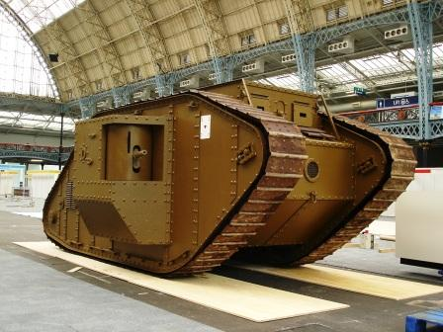
New Weapons
Machine Guns
  Refined to fit modern warfare
  600 Rounds per Minute
Airplanes
  Mostly for reconnaissance
  Later mounted guns for air fighting
Tanks
  Bulletproof
  Used to break through barbed wire

Slide 28
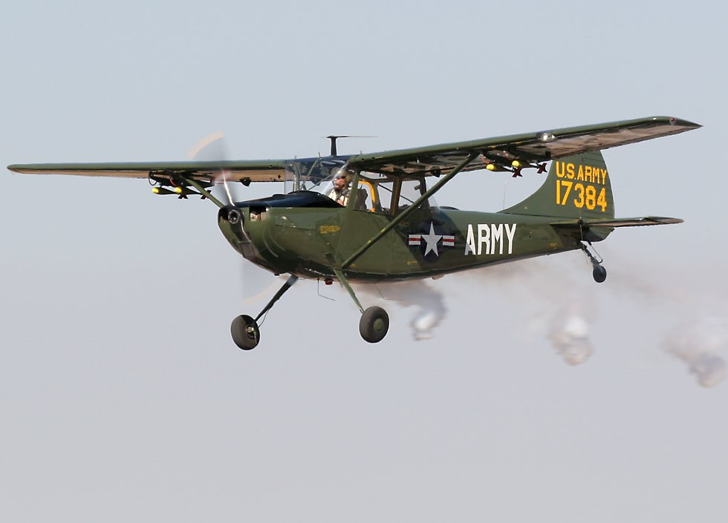
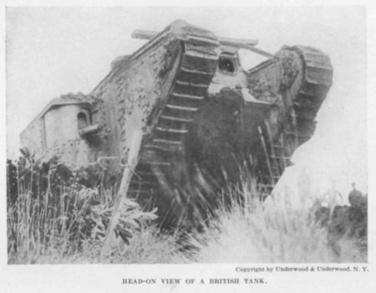
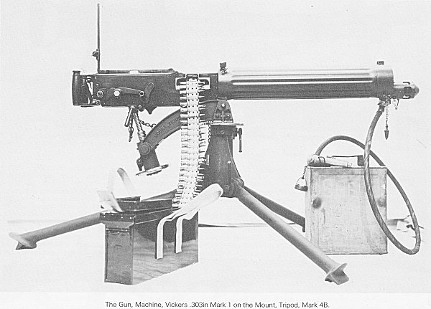
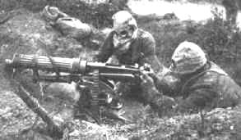
WW1 Weapons

Slide 29
Health Hazards and Conditions
In the Trenches
  Lice
  Rats
  Dirty water
  Dead bodies
  Trench foot
  Trench mouth

Slide 30
American War Hero
During the fighting at Meuse-Argonne:
  Alvin York becomes famous
  Killed 25 Germans with one rifle and one revolver and rescued 132 American prisoners
  Called the single greatest feat ever by an American private soldier.

Slide 31
Collapse of Germany
November 3, 1918
  Austria-Hungary surrenders to the allies
Germany’s surrender:
  In the 11th hour of the 11th day in the 11th month of 1918 Germany surrenders the war to the allies.

Slide 32
The Final Toll
Up to that point WW1 was the bloodiest war in history
World Losses
  Over 10,000,000 military deaths
  Over 11,000,000 civilian deaths
  Over 20,000,000 wounded
  Over 10,000,000 refugees
  $338 Billion in war costs
U.S. Losses
  48,000 men died in battle
  62,000 men died of disease in Europe
  200,000 wounded

Slide 33
The War At Home

Slide 34
War Industries Board
War Industries Board
  Est. 1917
  Under the leadership of Bernard M. Baruch
    WIB encouraged companies to use mass production techniques to increase efficiency
    Tried to get companies to eliminate waste by standardizing products
  Under the WIB industrial production in the US was increased by 20%
  …but retail prices double what they previously were

Slide 35
Railroad Administration
Had complete control over the railroads
  What they carried
  Where they were heading
  When they left and arrived

Slide 36
Fuel Administration
Fuel Administration
  Monitored coal supplies
  Rationed gasoline and heating oils
In order to conserve oil and gasoline they introduced daylight savings time
  Proposed by Ben Franklin in the 1770’s
  Took advantage of the longer days of Summer

Slide 37
War Economy
During the war years:
  Blue collar wages for jobs rose about 20% on average
  But the average household’s income could not keep up with the rising food and housing costs
In contrast to blue collar workers:
  Large corporations saw enormous profits
  Management was overpaid and laborers were under paid and overworked…
    As a result, many industries suffered from strikes.

Slide 38
National War Labor Board
Est. By President Woodrow Wilson in 1918
  Workers that refused to do what they were told would lose their draft exemption “Work or Fight”
Good changes for workers
  Improved factory conditions
  Pushed for an 8 hour work day
  Promoted factory inspections
  Banned child labor for good

Slide 39
Food Administration
To help produce and conserve food
  Established by President Wilson
    One day “sweetless”
    One day “meatless”
    One day “porkless”
    One day “wheatless”

Slide 40
Espionage and Sedation Acts
Espionage and Sedation Acts
  Passed by congress on May, 1918.
  A person could be fined $10,000 or 20 years in jail for saying anything negative about the war effort
  Definitely a violation of the 1st Amendment
  Targeted socialist and labor leaders

Slide 41
African Americans and the War
W.E.B. Dubois believed African Americans should support the war.
  Believed that if African Americans supported the war, more people would call for racial equality
Others believed that victims of racism should not support a racist government.
African Americans began the “Great Migration”
  Moving from rural southern states to big northern cities
  To escape the racist south (Jim Crow Laws)

Slide 42
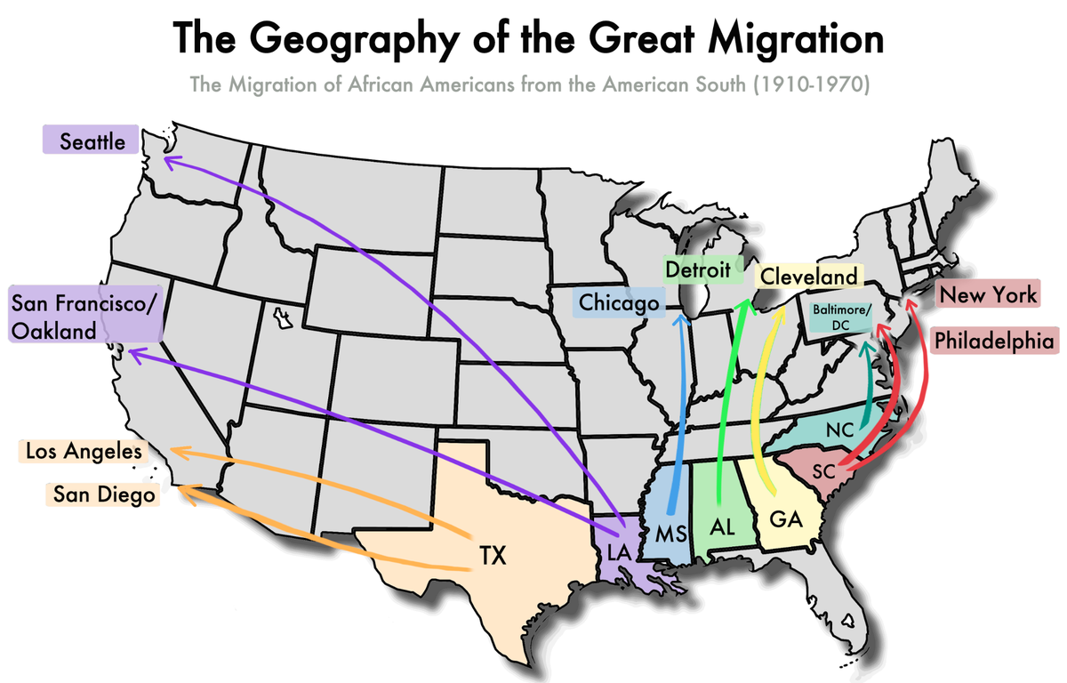

Slide 43
Women and the War
Began to work jobs that had previously been exclusively held by men.
  Railroad
  Cooks
  Dock workers
  Brick layers
  Coal Miners
1919 Congress passed the 19th Amendment
  Gave women the right to vote

Slide 44
Committee on Public Information
Committee on Public Information
  To popularize the war, the government established the nation’s first propaganda agency
    Biased information designed to influence peoples thoughts and actions

Slide 45
SELLING THE WAR
In groups of five create an ad campaign designed to encourage support of/ or create support against the war in Europe. Use your books to help you understand the state of America during the war. Who was prospering? Who was feeling the crunch of a wartime economy. Your ad campaign should encourage/discourage all sides to support/not support the war equally.
Your group will present a one to two minute commercial; be creative

Slide 46
Wilson Fights for Peace

Slide 47
Wilson Presents His Plan
Presented plan on January 18, 1918
  Wilson delivers his 14 points speech to Congress
    The first five points were issues that Wilson believed had to be addressed to prevent another world war.
    The next 8 points dealt with boundary changes
    The 14th point called for the creation of an international organization to address diplomatic crises
      League of Nations
        Provided a forum for nations to discuss and settle their grievances without having to resort to war.

Slide 48
The Allies Reject Wilson’s Plan
Wilson was naïve about how Allied leaders would accept his plan.
  Georges Clemenceau
    French Premier
    Lived through two German invasions
    Was determined to not let it happen again
  David Lloyd George
    British Prime Minister
    Just won re-election on the slogan “Make Germany Pay”

Slide 49
Debating The Treaty
Included none of the Central Powers
Russia didn’t attend because a communist government power took over
Wilson (US), Orlando (Italy), Clemenceau (France), George (Britain) all met to discuss the treaty.
Wilson conceded most of his 14 point but demanded the establishment of the League of Nations.

Slide 50
Treaty of Versailles
Signed by the Big Four and the leaders of the defeated nations in the Hall of Mirrors in the Palace of Versailles France
  Provision
    Established 9 new nations
    Germany could not maintain an army
    Germany had to pay 33 billion in reparations to the Allies

Slide 51
The Treaty’s Weaknesses
The treatment of Germany weakened the Treaty of Versailles's ability to provide lasting peace in Germany.
Basic Flaws in the treaty:
  It humiliated Germany
    Contained a War Guilt Clause
      Germany had to accept sole responsibility for starting the war
  The reparations were too high for Germany to pay

Slide 52
Opposition to the Treaty
When Wilson returned to the US, he faced strong opposition to the treaty.
  Herbert Hoover
    Believed that the treaty was too harsh and would cripple Europe economically
Debate over the League of Nations
  Henry Cabot Lodge
    Believed that the League of Nations threatened U.S. foreign policy.
    Suspicious of some of the provision in the treaty

Slide 53
Wilson Refuses to Compromise
Wilson unwisely ignores the Senate’s opposition to the treaty.
Wilson sets out on a 8,000 mile trip across the US to gain support of the people
  While touring, he has a stroke and is mostly paralyzed for 2 months.
  Senate confirms the treaty but adds amendments
  The US never joined the League of Nations

Slide 54
The Legacy of the Wars
Americans came to call WW1 “The War to End All Wars”
The Long Run
  Europe was still in turmoil
  The Treaty of Versailles accomplished nothing
  Most Europeans wanted to resume the fight

