Slide 1
WORLD PROBLEMS FOLLOWING WWI
  Treaty of Versailles
    The treaty that ended WWI
    Caused anger and resentment instead of creating peace
    Germany had to give up military and take blame for starting the war

Slide 2
DICTATE THIS

Slide 3
THE RISE OF THE DICTATORS
Joseph Stalin
Benito Mussolini
Adolf Hitler

Slide 4
THE UNITED STATES’ ROLE

Slide 5
HITLER’S NEXT MOVES

Slide 6
Austria and Czechoslovakia
November 5, 1937
  Hitler meets with his top advisors
  Reveals his plan to annex Austria and Czechoslovakia

Slide 7
Union With Austria
Austria
  Hitler’s 1st target
  Most Austrian’s spoke German and favored a unity
March 12, 1938
  Hitler’s forces march into Austria and take over unopposed.
  The US and the rest of the world did nothing

Slide 8
Bargaining for Sudetenland
Sudetenland
  Western Czechoslovakia
  Home to 3 million German-speaking people
  Hitler wants the natural resources and extra land
  He makes up atrocities about Czechoslovakia
  He publishes propaganda to get the German people outraged

Slide 9
FRANCE & BRITAIN’S RESPONSE

Slide 10
France and Britain’s Promise
Early in the Conflict
  Britain and France promised to protect Czech.
When war seemed inevitable:
  Hitler invites the French Premier Edouard Daladier and British Prime Minister Neville Chamberlain to meet in Munich.
  Hitler assured them he would take no more land in Europe.

Slide 11
Munich Agreement
Munich Agreement
  Stated that Hitler would not annex anymore of Europe
  Signed by Daladier and Chamberlain
  Winston Churchill of Britain did not agree with the Munich Agreement or with Chamberlain’s passive attitude toward Hitler.
“Britain and France had to choose between war and dishonor. They chose dishonor. They will have war.” Winston Churchill’s response to the signing of the Munich Agreement

Slide 12
MEAN WHILE IN THE USSR

Slide 13
Soviets Declare Neutrality
Poland
  Had a large population of German speaking citizens
  Hitler then begins a propaganda campaign stating that Polish-Germans were being mistreated.
  Hitler signs a non-aggression pact with Stalin (Russia).
  August 23, 1939
    Hitler and Stalin sign another, secret pact agreeing to divide Poland equally.

Slide 14
BUT HITLER HAD OTHER IDEAS

Slide 15
Blitzkrieg In Poland
September 1, 1939
  The German air force attacks Poland
  Destroyed: Military bases, important roads, railroads and major cities.
  The first test of Germany’s new war strategy the blitzkrieg, or lightning war.
Directly after the Blitzkrieg
  France and Britain declare war on Germany
  Poland ceases to exist
  WWII has officially begun.

Slide 16
The Fall of France
The German Offensive
  Trapped 400,000 French and British soldiers trying to flee Dunkirk (French side of the English Channel)
  Italy enters the War on Germany’s side
  Germany marches toward Paris in the North, Italy marches from the South.
  France Falls
  French General Charles de Gaulle flees to England.

Slide 17
The Battle of Britain
Summer 1940
  Hitler begins a series of air raids on London
  2600 planes bombed London for 2 straight months
September 15, 1940
  Royal Air Force
    Using radar, the RAF shot down 185 German planes and only lost 26

Slide 18
The US in World War II

Slide 19
Selective Service and the GI
After Pearl Harbor:
  5 million men joined the military
  The government used selective service to provide another 10 million soldiers
Basic Training in WWII
  8 weeks
  Tried to get the GI’s ready for war

Slide 20
Expanding the Military
George Marshall
  Army Chief of Staff
  Pushed for the Women’s Auxiliary Army Corps (WAAC)
    Women served in non combat positions
      Nurses
      Radio operators
      Electricians
      Ambulance Drivers

Slide 21
Minority Groups in the Army
Minorities in the Army
  300,000 Mexican Americans
  1,000,000 African Americans
  13,000 Chinese Americans
  33,000 Japanese Americans
  25,000 Native Americans

Slide 22
Industrial Response
All automotive plants stopped producing cars for private use.
Car Factories built:
  Tanks
  Planes
  Boats
Other Industrial Factories made weapons and bombs.

Slide 23
Mobilization of Scientists
1941
  FDR creates the Office of Scientific Research and Development (OSRD)
    Created :
      advanced sonar and radar
      Pesticides to keep the soldiers from getting body lice
      Penicillin- saved countless lives on and off the battlefields
  Manhattan Project
    Created to research uranium
    Scientist created the first atomic bomb by splitting an atom of uranium.

Slide 24
Economic Controls
Office of Price Administration (OPA)
  Est. by FDR to keep consumer prices from rising during the war.
War Production Board (WPB)
  Turned peace time companies to war time companies
  Collected scrap metal, cans, paper and rags for use in the war effort.

Slide 25
The War for Europe and Africa

Slide 26
War Plans
Churchill comes to America to meet with FDR
  3 Weeks after Pearl Harbor
  Churchill tries to convince FDR to go after Hitler before the Japanese.

Slide 27
Battle of Stalingrad
Stalingrad
  Summer 1942
    The Germans raid Stalingrad taking it down one house at a time
    Most fighting was brutal hand to hand combat
  October 1942
    Germans control 9/10 of the city
  Winter
    The Russians saw the cold winter as an opportunity
    The Russians surround Stalingrad and trap the Germans in
    They cut the Germans supplies off and made them starve and freeze until the Germans surrendered.
***Stalingrad was the turning point in the War***

Slide 28
Operation Torch
Operation Torch
  1942
    The axis Powers Controls the North African Coast
  Led by General Dwight D. Eisenhower
    107,000 Allied troops land in Africa
    They chased down the Afrika Corps led by General Erwin Rommel (The Desert Fox)

Slide 29
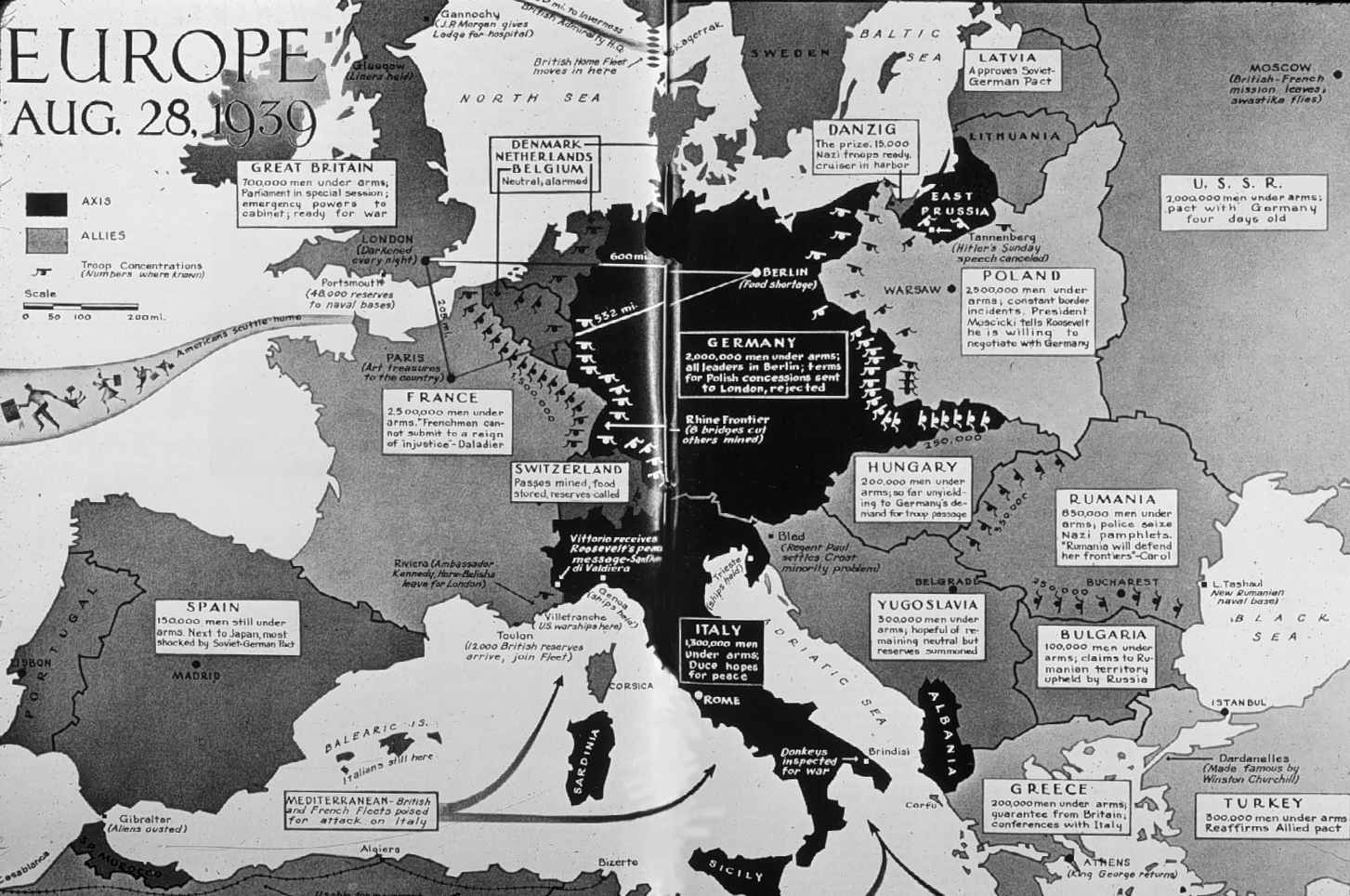

Slide 30
Liberating Europe
D-DAY and Operation Overlord
  June 6, 1944
    Led by Eisenhower
    Largest sea air and land operation in history
    3 million British and American soldiers

Slide 31
Overlord Result
Within 7 days after D-day:
  The Allies held an 80 mile strip of France
General Patton’s 3rd Army
  Marches in toward Paris
  Crosses the Seine River into Paris and liberates the French Capital from German captivity.
  Wrote a letter of joy to Eisenhower “Dear Ike, today I pissed in the Seine.”

Slide 32
Battle of the Bulge
Battle of the Bulge
  Germany’s last attempt to stop the Allies
  Fighting lasted a month
  The Germans captured 120 American GIs, lined them up in a field and mowed them down with machine guns.
When the battle was over
  The Germans had lost 120,000 troops
  Lost 600 tanks and assault weapons
  Lost 1,600 Planes
    From that point on the Nazi’s could do little to retreat.

Slide 33
Liberation of the Death Camps
The allies march deep into Germany and Poland
  The Russians were the first to discover the death camps
    When they arrived at the first death camp:
      SS Officers were working feverishly to bury and hide the evidence.
      Thousands of starving prisoners were too weak to know what was happening
      They found a crematorium storehouse containing over 800,000 pairs of shoes.

Slide 34
Unconditional Surrender
April 25, 1945
  The Soviets surround Berlin
  Hitler hid in his Bunker and prepared for the end
    He marries his long-time companion Eva Braun on April, 29.
    The next day Hitler and Eva Braun committed suicide.
    Their bodies were then drenched in gasoline and burned.

Slide 35
V-E Day
May 8, 1945
  Eisenhower accepts unconditional surrender from the Third Reich
  The allies celebrated V-E Day, or (Victory in Europe Day)
Roosevelt’s Death
  FDR did not make it to see V-E Day
  He died on April 12 while posing for a picture
  Harry Truman took over as the 33rd President of the US.

Slide 36
War in the Pacific

Slide 37
Japanese Advances
In the 6 months after Pearl Harbor:
  The Japanese had established an empire much larger than Hitler’s Third Reich
  Japanese conquered
    Dutch East Indies
    French Indonesia
    Malaya
    Burma
    Hong Kong
    Thailand
    China

Slide 38
Battle of Midway
Midway
  A strategic island in the Pacific (North of Hawaii)
June 3, 1942
  Americans intercept Japanese transmissions and know that the next target is Midway.
  The US send in torpedo planes and dive bombers to take out the fleet.
When the battle was over
  4 aircraft carrier, a cruiser, 250 planes
  Known as the turning point of the war in the Pacific

Slide 39
Japanese Defense
Kamikaze
  New Japanese war tactic
  Meaning “Divine Wind”
  Suicide Pilots that would strap bombs to their planes and fly the plane into US battleships

Slide 40
Iwo Jima
Iwo Jima
  Japanese Island
  The most heavily defended spot on earth at that point
  General Douglas MacArthur
    US General
      Under his leadership:
        6000 marines die
        20,500 Japanese troops are killed

Slide 41
Okinawa
April 1945,
  US Marines invade Okinawa
  The Japanese unleash over 1,900 kamikaze
    Sunk 30 ships and killed 5,000 men
  Once the US reach land they faced even more fierce opposition
By the end of the fighting
  7,600 Americans had died
  110,000 Japanese had died

Slide 42
Atomic Bomb Ends the War
Manhattan Project
  Led by scientist J. Robert Oppenheimer
  Development of the atomic bomb
  600,000 Americans worked on this project
  Best kept American War secret
The first test
  July 16, 1945
    New Mexico desert
    When it hit a blinding light that could be seen for 180 miles
    Followed by a massive shock wave that shook the entire desert

Slide 43
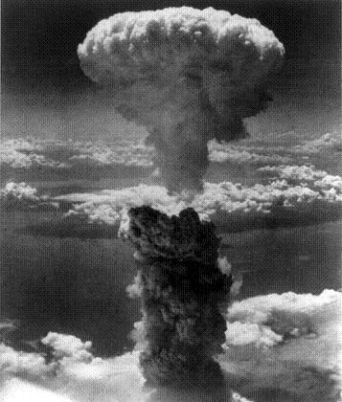
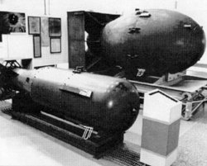

Slide 44
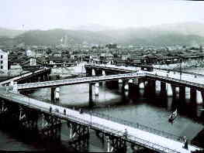
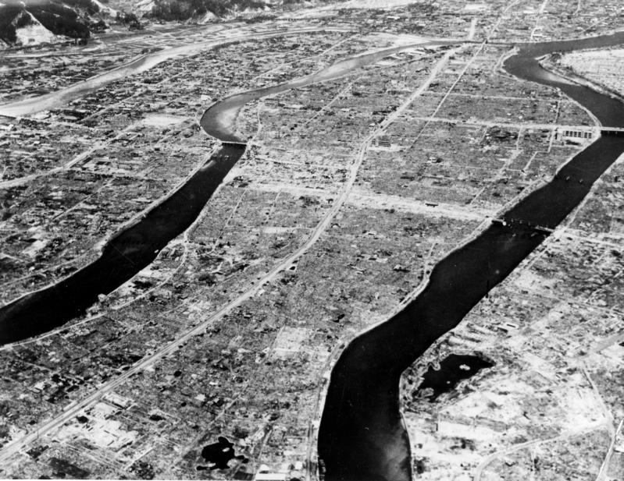

Slide 45
Hiroshima and Nagasaki
August 6, 1945
  President Truman gives the ok to drop the bomb
  B-29 Bomber named Enola Gay, released an a-bomb code named Little Boy on Hiroshima
    43 seconds later, every building in the city was turned to dust.
    Japan still refused to surrender
  3 days after Hiroshima
    Second bomb code named Fat Man was dropped on Nagasaki
    Over 200,ooo people died as a result of the bomb droppings
  September 2 the Japanese officially surrender.

Slide 46
The Holocaust

Slide 47
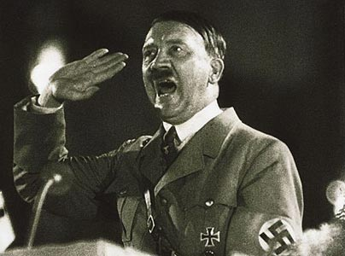
The Persecution Begins
April 7, 1933
  Hitler orders all “non-Aryans” be removed from government jobs
    1st move towards the Holocaust
      Holocaust- systematic killing of over 6 million Jews

Slide 48
Jews Targeted
Anti-Semitism in Europe
  Jews were the scapegoats for many of the European problems
  Hitler believed the Jews caused Germany’s economic problems
1935
  Nuremburg Laws
    Stripped all Jews of German citizenship

Slide 49
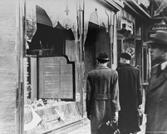
Kristallnact
“The Night of Broken Glass”
  November 9-10, 1938
    Nazi storm-troopers attacked Jewish homes and businesses
      Windows busted out
      Houses burned to the ground
      100 Jews dead
      30,000 Jews arrested

Slide 50
A Flood of Jewish Refugees
Fleeing Jews
  After Kristallnacht many Jews began to flee Germany
    Many countries would not accept the Jewish refugees
The Plight of The St. Louis
  Miami 1939
    The German boat St. Louis tried to enter America
    Sent back by the coast guard
    More than half of the 1000 people on the boat ended up being killed in the holocaust.

Slide 51
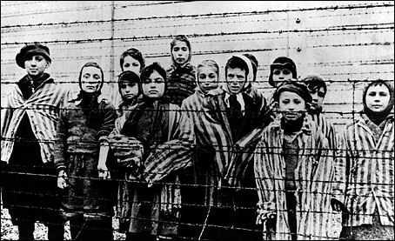
Hitler’s “Final Solution”
Genocide
  The Condemned
    Gypsies
    Freemasons
    Jehovah's Witnesses
    Homosexuals
    Mentally Handicapped
    Physically disabled

Slide 52
Forced Relocation
Ghettos
  Segregated Jewish communities in certain Polish cities
    The Germans surrounded the Ghettos with stone walls and barbed wire
Life in the Ghettos
  Dead bodies piled up
  People starving to death

Slide 53
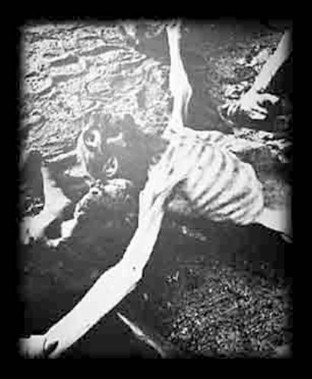
Concentration Camps
Concentration Camps
  “Labor Camps”
    Families separated forever
    Starvation
    Thousands of people crammed into spaces made for a couple hundred
    Worked from dusk till dawn with little or no food
    If a Jew was too weak to work, he was killed

Slide 54
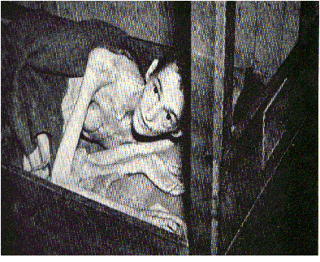
The Final Stage
1942 the Final Solution Beings
  Mass Extermination
    The starvation, beating and bullets were not killing the Jews at a fast enough rate to satisfy the Nazis
  Nazis built 6 Death camps in Poland
    1st camp opened- Chelmno
    Largest Death Camp- Auschwitz

Slide 55
A Day at a Death Camp
Don’t Write
The Jews would be forced to enter
They were forced to relinquish all belongings
They passed through doctors and were separated
  The strong went to work
  The weak were killed that day

Slide 56
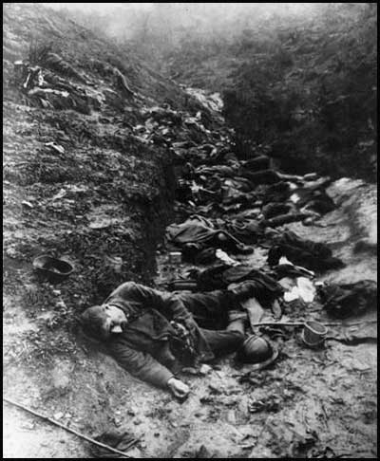
Mass Murder
Death Camps
  Capable of killing 12,000 Jews per camp, every day
  The stench of rotting corpses could be smelled for miles away
  Nazis worked all day digging graves and emptying gas chambers

Slide 57
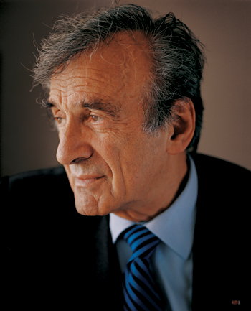
The Survivors
6,000,000 Jews were killed in the Holocaust
Some did survive the horrors of the holocaust
The survivors were changed for the rest of their life.

