Slide 1
THIS IS MYSTORY: THE HISTORY OF GREGG MAYS

Slide 2
PRESENT DAY GREGG MAYS
HUSBAND OF 27 YEARS
FATHER OF ONE DAUGHTER
ACTIVE MEMBER IN A LOCAL CHURCH
HIGH SCHOOL TEACHER
RETIRED MILITARY MEMBER
LOW KEY RAPPER

Slide 3
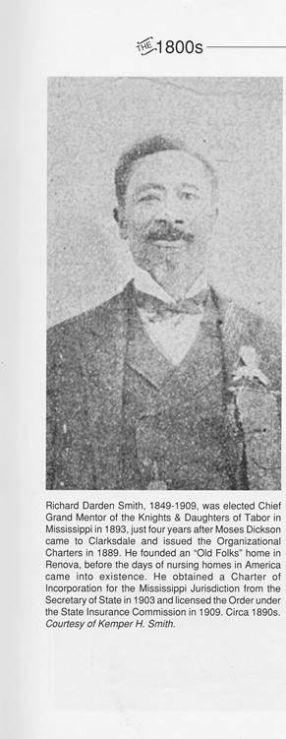
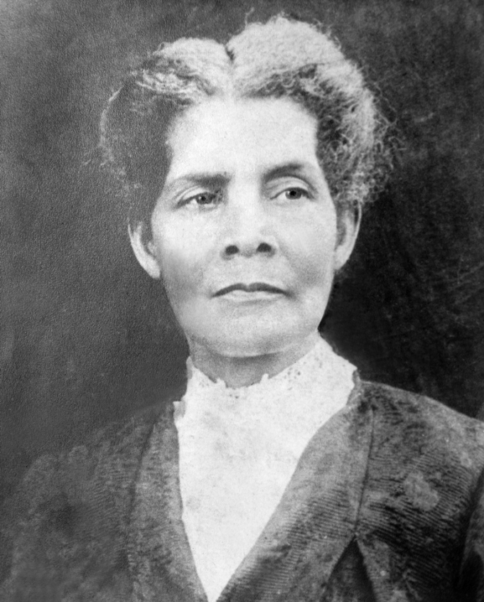
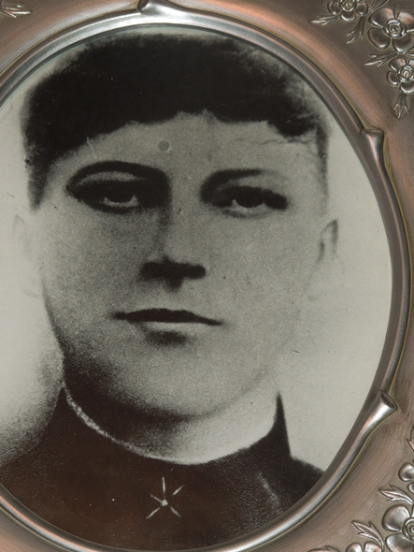
HOW DID I GET HERE
MILLIE FIELDS
DORA WALTON WILLIAMS

Slide 4
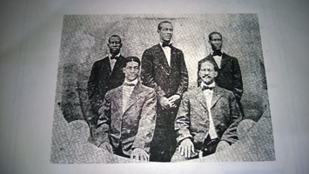
Sons of Richard Smith and Millie Fields: Walter Davis Smith, Perry Monroe Smith, William Lafayette Smith, Moses Alexander Smith and Arthur Smith (died young w/no descendants)

Slide 5
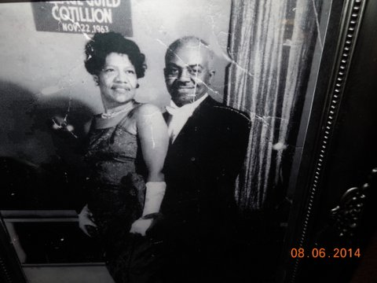

Slide 6
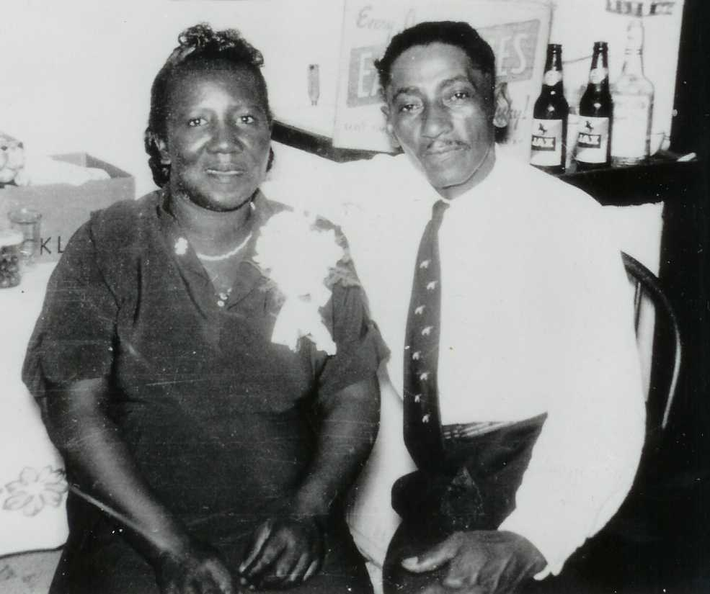

Slide 7
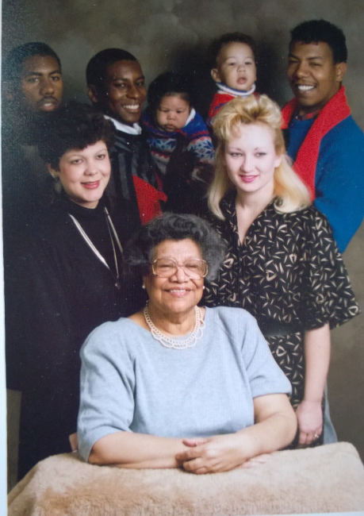

Slide 8
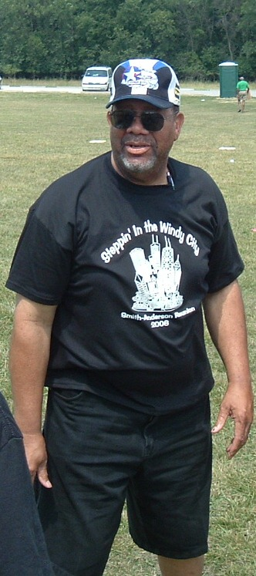

Slide 9
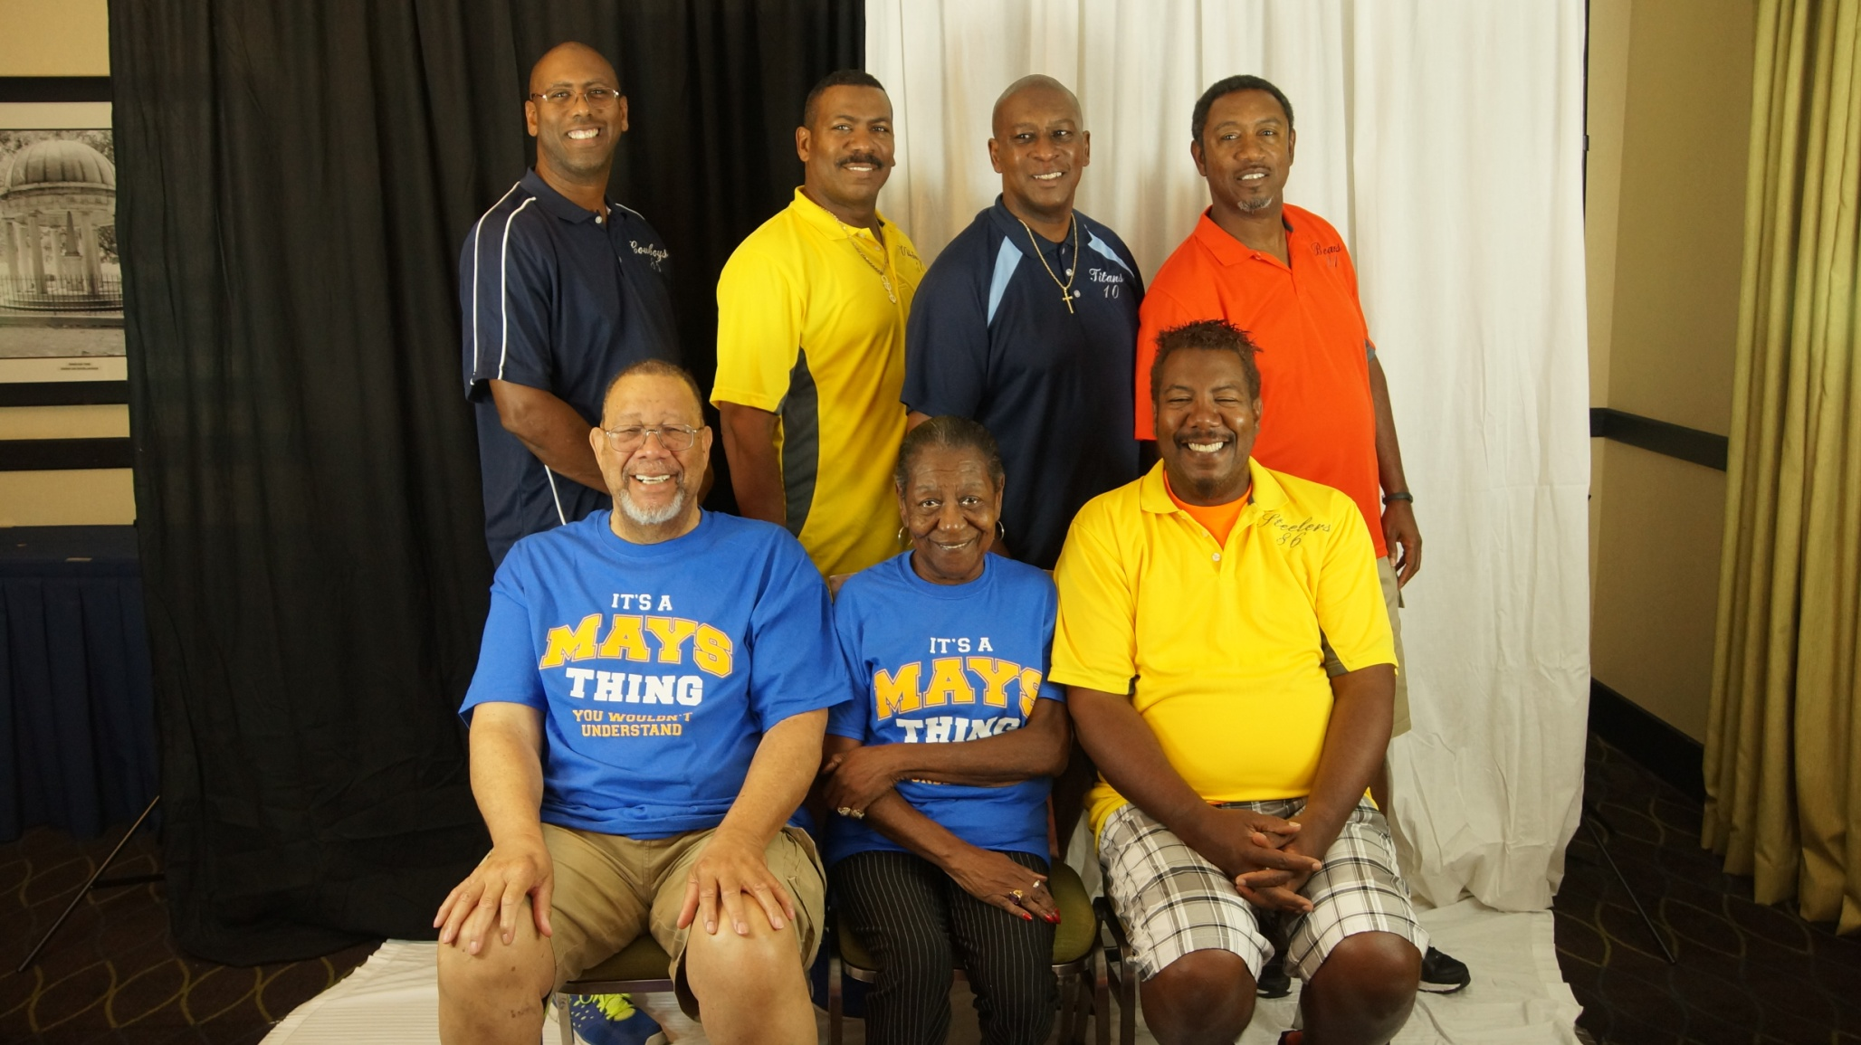

Slide 10
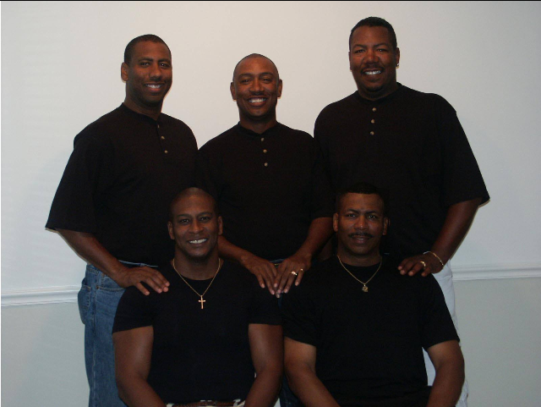

Slide 11
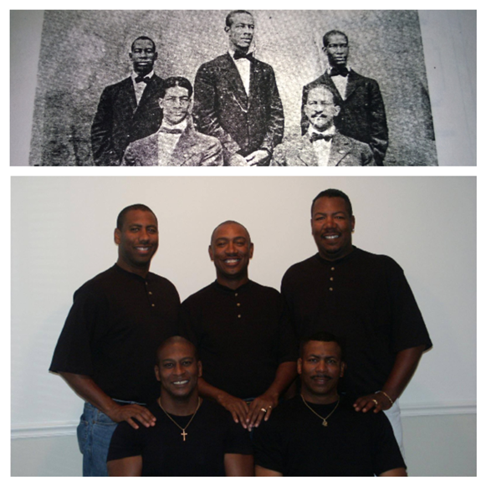
HISTORY SOMETIMES REPEATS

Slide 12
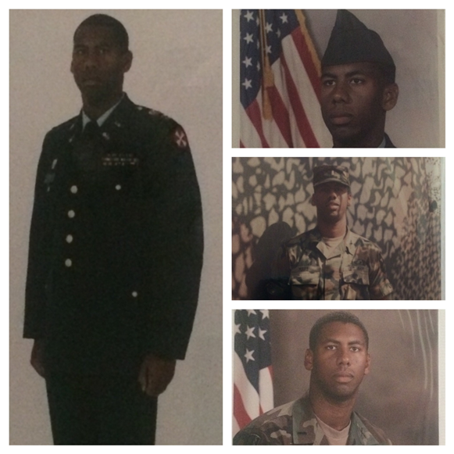

Slide 13
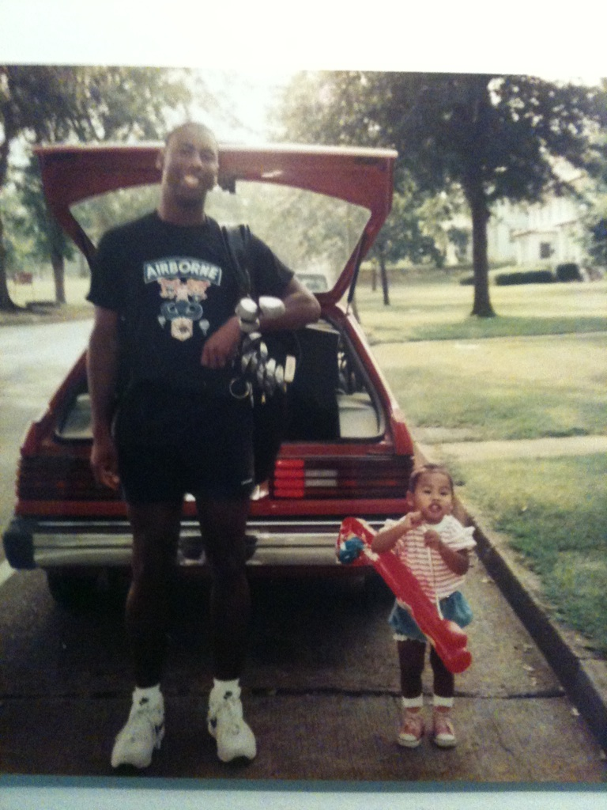
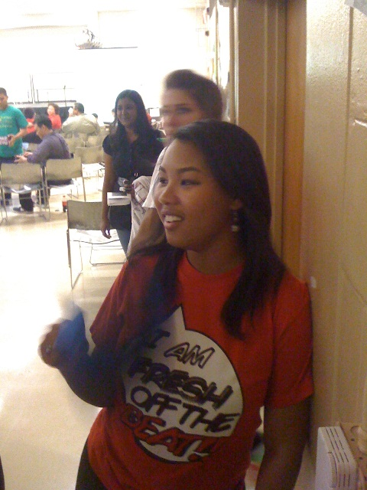
THE LEGACY CONTINUES

Slide 14
GREGG MAYS

