Slide 1
IN YOUR GROUP
Create a Monthly Budget Using these Items as a guide. You may add to the list as you see fit.
Mortgage/Rent Leisure/Hobbies
Transportation Donations
Utilities (Elec/Water/N. Gas) Vacations
Telephone (home/cell) Food (for the home/rest.)
Education Clothing
Entertainment Children Allowance
Insurance (health/dental/life) Savings

Slide 2
Our Nation’s Sick Economy

Slide 3
Industries in Trouble
Railroad, Steel and Textile industries were not making profit.
Major Indicator
Housing market goes down
All related industries also fall
Furniture
Lumber
Building supplies

Slide 4
Consumers Have Less Money to Spend
As incomes fall, consumers spend less money.
Prices are rising
Incomes are staying the same
Unbalanced distribution of income
Overbuying credit

Slide 5
Credit and Distribution of Wealth
1920s
People appeared wealthy, but they were living on credit.
People were living beyond their means.
The rich got richer, the poor got poorer
75% of the nation’s families were making only $2,500 per year

Slide 6
Dreams of Riches in the Stock Markets
Dow Jones Industrial Avg.
The most widely used barometer of the stock market’s health
Stock Market Troubles
Americans were rushing to market to try to turn a quick profit
People were investing in industries they had no idea about and were borrowing to do so.

Slide 7
The Stock Market Collapse
September 1929
The stock market peaks, and then falls
October 24, 1929
Market takes a huge plunge and people begin to pull their money out.
October 29, 1929
Black Tuesday
The stock market crashes

Slide 8
Financial Collapse
The Crash of 1929 signaled the beginning of the “Great Depression”
The economy plummeted and unemployment skyrocketed

Slide 9
Bank and Business Failures
Panicked people try to get their money from the banks, but couldn’t because the banks had invested the money.
By 1933, 11,000 of the nation’s 25,000 banks had collapsed.
The nation’s GDP was cut in half
90,000 businesses went bankrupt

Slide 10
Hawley Smoot Tariff
Hawley-Smoot Tariff
1930
Passed by congress
Placed trade embargos on farmed products from other countries
The Effect of the Tariff
Countries place tariffs on our goods
Import/export businesses took a hit

Slide 11
Causes of the Depression
Tariffs and war debt that cut on foreign market for American goods.
A Crisis in the farm sector
Availability of easy credit
Unequal Distribution of Income

Slide 12
During The Depression

Slide 13
Hardship and Suffering During the Depression
Depression in the Cities
In all the major cities in the US people were losing their jobs and being evicted from their homes.
People were living in shantytowns.
Towns of makeshift house made from:
Metal scraps
Boxes
Newspapers
Old Car Bodies

Slide 14
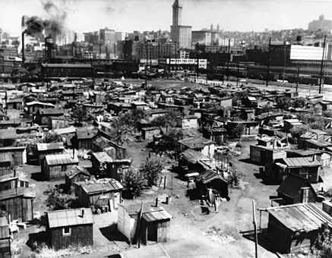
Shanty Towns

Slide 15
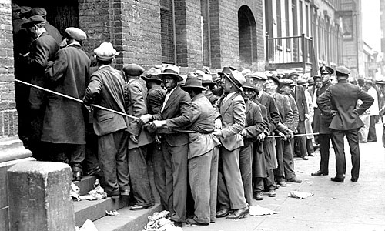
Depression in the Cities
To eat:
The poor dug through trash cans to find scraps
Soup Kitchens- offered free or low cost food
Bread Lines- food provided to the poor by charitable organizations.

Slide 16
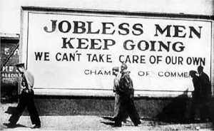
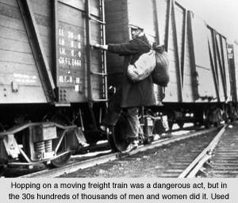
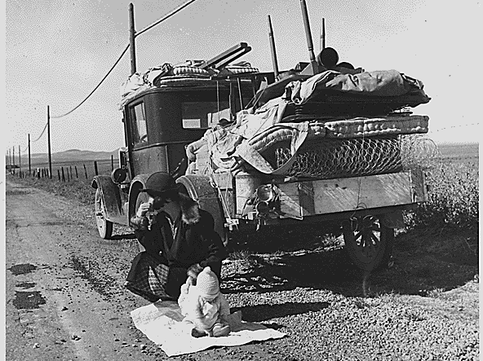

Slide 17
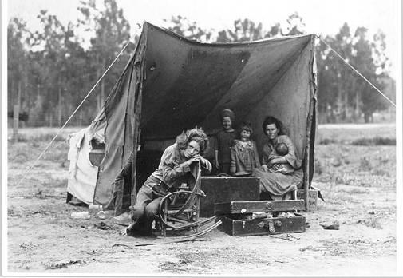
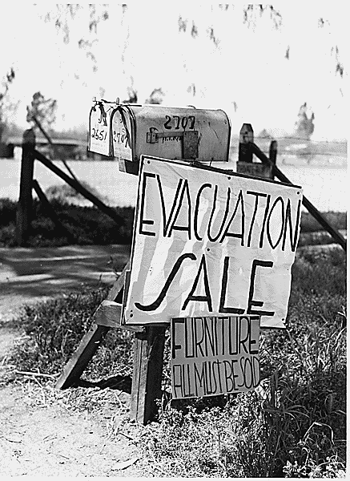
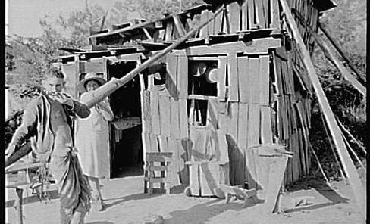
Mortgage Foreclosures

Slide 18
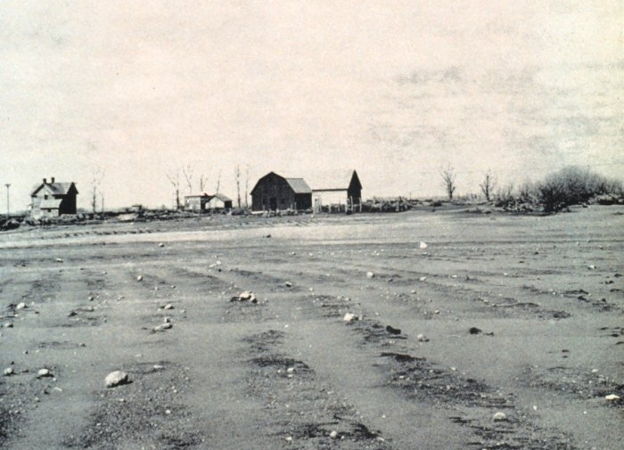
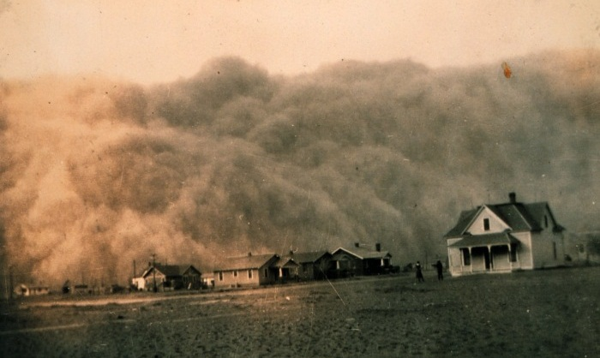
The effects of the depression were made worse by the Dust Bowl
Decades of over-farming and droughts in the Plains led to windstorms that swept away soil and made farming impossible

Slide 19
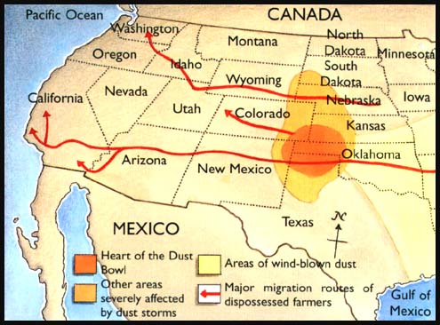
Farmers in the Plains (called “Okies” and “Arkies” left their farms and searched for work or for better land in West coast states
Notes:
Financial Collapse
The stock market crash signaled the beginning of the Great Depression—the period from 1929 to 1940 in which the economy plummeted and unemployment skyrocketed. The crash alone did not cause the Great Depression, but it hastened the collapse of the economy and made the depression more severe.
BANK AND BUSINESS FAILURES After the crash, many people panicked and withdrew their money from banks. But
some couldn’t get their money because the banks had invested it in the stock market. In 1929, 600 banks closed. By 1933, 11,000 of the nation’s 25,000 banks had failed. Because the government did not protect or insure bank accounts, millions of people lost their savings accounts. The Great Depression hit other businesses, too. Between 1929 and 1932, the gross national product—the nation’s total output of goods and services—was cut nearly in half, from $104 billion to $59 billion. Approximately 90,000 businesses went bankrupt. Among these failed enterprises were once-prosperous automobile and railroad companies. As the economy plunged into a tailspin, millions of workers lost their jobs. Unemployment leaped from 3 percent (1.6 million workers) in 1929 to 25 percent (13 million workers) in 1933. One out of every four workers was out of a job. Those who kept their jobs faced pay cuts and reduced hours.

Slide 20
The Dust Bowl
In the 1930s a drought begins in the Great Plains.
The land had been over-cultivated and was no longer fertile
A huge layer of dust formed on the top of the earth as a result of the over-use
Kansas, Oklahoma, Texas, New Mexico and Colorado became known as the Dust Bowl.
1934 a windstorm picked up millions of tons of dust and blew it into the east coast cities.

Slide 21
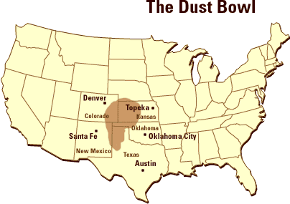
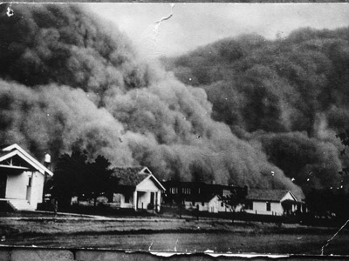

Slide 22
The Dust Bowl Video

Slide 23
Hoover Struggles with Depression

Slide 24
Democrats Win in 1930 Election
1930
The country’s economic crisis was getting worse.
When the Congressional election came around in 1930 the anti-Hoover sentiment carried over.
Voters turned against the Republican party because of the Great Depression and voted mostly for democrats to fill congressional seats.

Slide 25
The Bonus Army
The Bonus Army
In Spring of 1932, 10,000-20,000 WW1 veterans showed up in Washington.
The bonus army supported a bill that was in congress. (Patman Bill)
Wright Patman
Congressman who wrote the bill.
The bill stated that veterans should receive their lifetime insurance policy in the form of cash to be paid immediately.

Slide 26
Hoover Disbands the Bonus Army
Hoover was nervous that group would become violent and he ordered them to leave.
Most of the people did leave, but about 2,000 people stayed.
Under the command of Douglas MacArthur, the 12th infantry forced the bonus soldiers to disband.

