Slide 1
Sectionalism
1800-1861

Slide 2
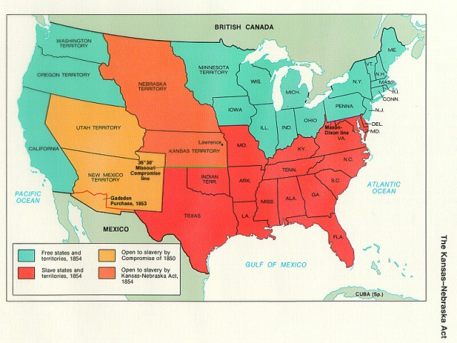
What is sectionalism?
The economic, social, and political difference between different sections of the country (North vs. South)

Slide 3
Sectionalism: North vs. South
North
South
Economy based on industry (factories)
Against the spread of slavery into the western territories
Believed the Federal Government should have power over the states
Economy based on agriculture (farming)
Supported the spread of slavery into the western territories
Believed the States should have power over the Federal Government

Slide 4
How did the political system attempt to resolve the issues of sectionalism and slavery?

Slide 5
The Missouri Compromise
In 1820, there were 12 slave states and 12 free states.
  The perfect balance between slave and free states was disrupted when Missouri applied to enter the United States as a slave state.
  In order to get the northern anti-slavery states to agree to let Missouri become a state, the south had to agree to a compromise.

Slide 6
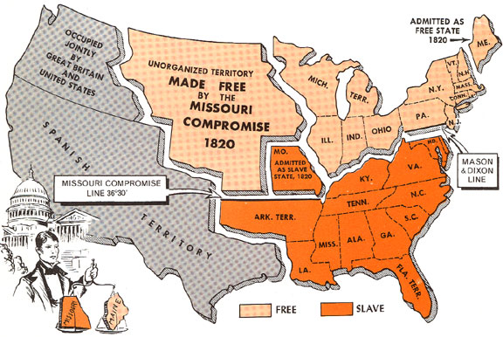
The terms of the Missouri Compromise of 1820:
  Missouri enters as a slave state
  Maine becomes a free state (now there would be 13 slave states and 13 free)
  Slaves would not be allowed north of the 36-30 line in the western territories

Slide 7
Between 1820-1850 the idea of Popular Sovereignty became widespread as a way of solving the slavery debate when territories wanted to become states:
  Popular Sovereignty - the idea that the residents of each territory should get to vote whether their state is free or slave.

Slide 8
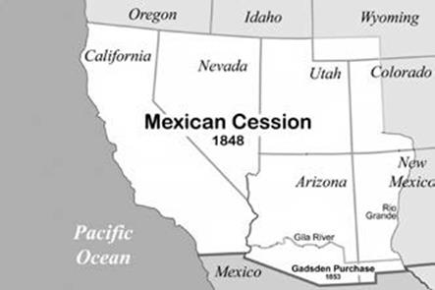
The Missouri Compromise eased the tensions between North and South until after the conclusion of the Mexican War in 1848
  After the war, slave owners began to move slavery into the territory that was won from Mexico (Modern day California, New Mexico, Arizona and Utah)

Slide 9
The Compromise of 1850
In 1850, California applied to join the United States as a free state (the South did not like this)
  In order to ease the anger of the South, now the North would need to agree to a compromise:
The terms of the Compromise of 1850:
  California enters as a free state
  New Mexico and Utah would be decided by a vote of the people (Popular Sovereignty)
  The North would have to enforce the new Fugitive Slave Law, which required to the North to return runaway slaves to the South.

Slide 10
The Kansas-Nebraska Act
  Proposed allowing Kansas and Nebraska to become states using the method of popular sovereignty (the people choose whether they are slave or free)
  For this plan to work, the Missouri Compromise had to be repealed.

Slide 11
The Abolition Movement

Slide 12
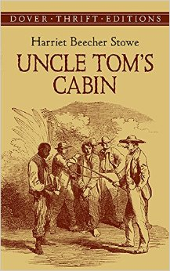
1840s-1850s - a small movement called abolitionism started in the North
  Abolitionists wanted slavery banned from the United States of America.
  The movement was slow at first, but in 1852, Harriet Beecher Stowe published a book called, Uncle Tom’s Cabin
    Detailed the horrors of slave life in the south
    Made support for abolition grow quickly.

Slide 13
The Fugitive Slave Law
  Passed as part of the Compromise of 1850
    Required Northern law enforcement to help capture and return runaway slaves to the South.
  The law was hated, and disobeyed by many Northern abolitionists.
  The only way a runaway slave would be safe was to escape all the way to Canada.

Slide 14
The Underground Railroad
The Underground Railroad was another way that Northern abolitionists helped to fight against Southern slavery.
  The Underground Railroad was a secret escape route with various stops on the way from the South to Canada.
    Thousands of slaves were liberated through the Underground Railroad
      Harriett Tubman is the most famous of the Underground Railroad leaders.

Slide 15
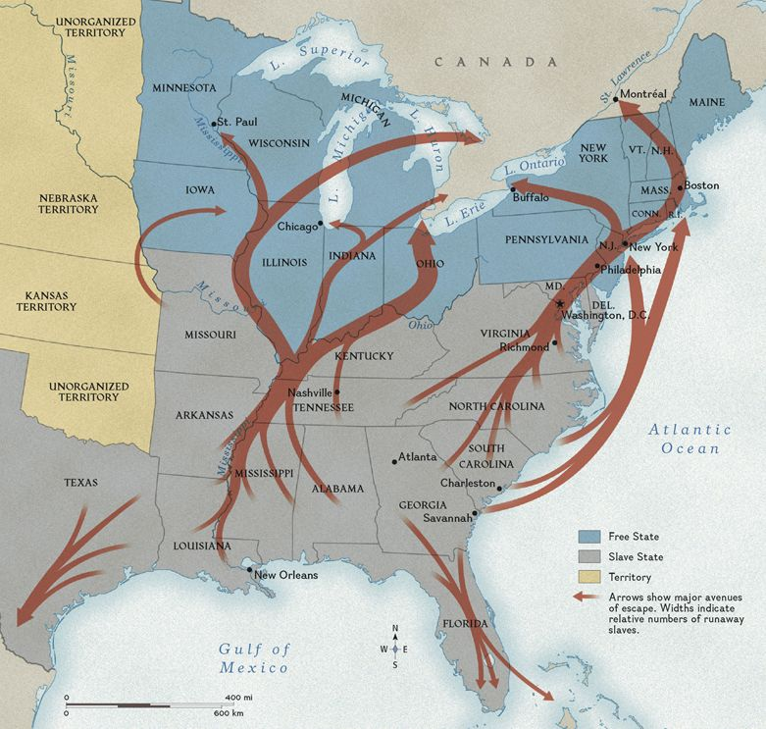

Slide 16
Why did the Underground Railroad go all the way to
Canada, and not simply stop in the free North?

Slide 17
Secession, and the formation of the Confederate States of America

Slide 18
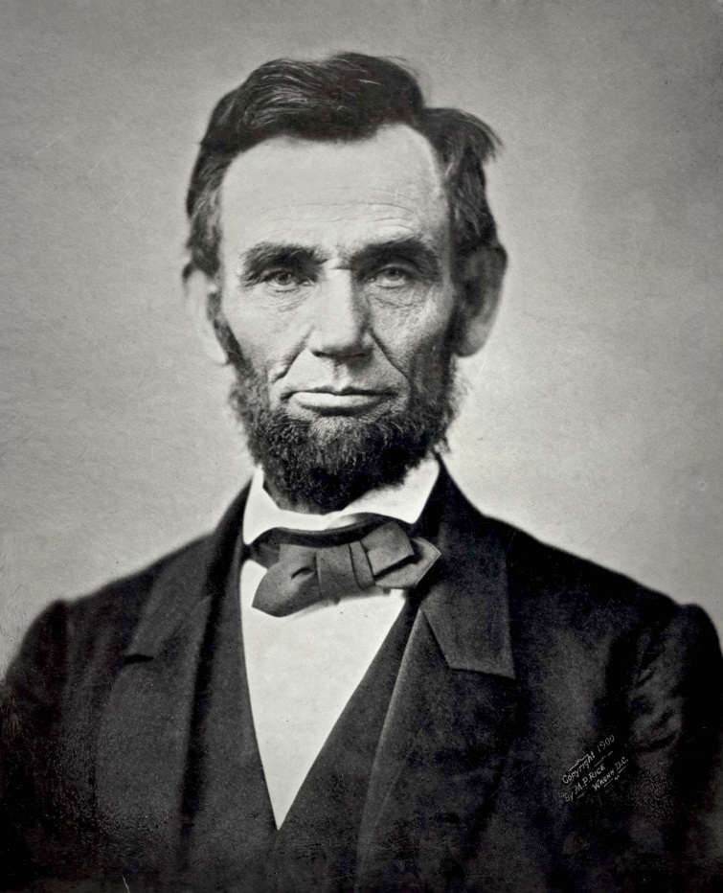
In 1860, the Republican presidential candidate, Abraham Lincoln, won the election.
  The South thought Lincoln would outlaw slavery
  South Carolina decided that secession (breaking away) from the United States was the only option.
    Eventually 10 more states followed.

Slide 19
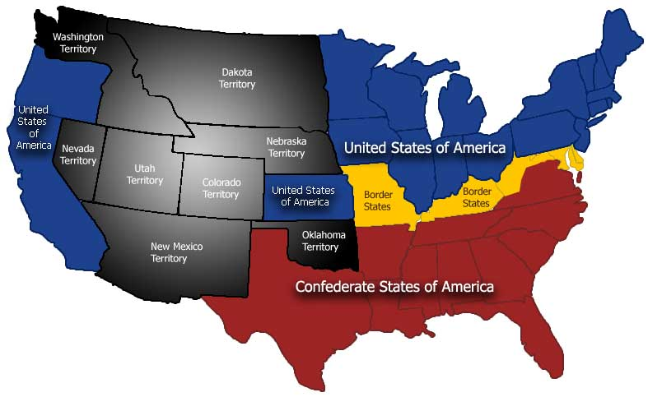
11 states broke away to form the Confederate States of America.
20 anti-slave states remained in the Union
4 slave states remained in the Union (referred to as border states)

Slide 20
After the troubles and divisions of the Civil War, what was needed to help the nation come together again?

Slide 21
Reconstruction
1865-1877

Slide 22
Reconstruction
The process of restoring, rebuilding, and readmitting the Confederate States to the United States

Slide 23
Congressional Plans
The Radical Republicans
  Republicans who were strongly antislavery
  did not want to forgive the confederates
  Passed laws that provided rights for African Americans
  Punished southern Democrats with harsh laws

Slide 24
Opposing Reconstruction Plans
President Lincoln’s Reconstruction Plan
  Granted amnesty to the south, on the condition that 10% of eligible voting men in each rebellious state would swear allegiance to the Union
The Radical Republicans
  A sect within the Republican Party that wanted to make the punishment on the Confederate States extremely difficult
    Wanted 50% of eligible voting men in each rebellious state to swear allegiance to the Union in order to rejoin

Slide 25
Why was President Lincoln’s reconstruction plan so lenient compared to other members of the Republican Party?

Slide 26
Civil Rights Amendments
Passed by congress:
  13th Amendment (1866) - Outlawed slavery in the United States
  14th Amendment (1868) - Granted citizenship to all African Americans
  15th Amendment (1870) - No citizen could be denied the right to vote based on color or race

Slide 27
The Radicals Take Over
After President Lincoln was assassinated, the Radical Republicans took control of the reconstruction process… and they made it difficult.

Slide 28
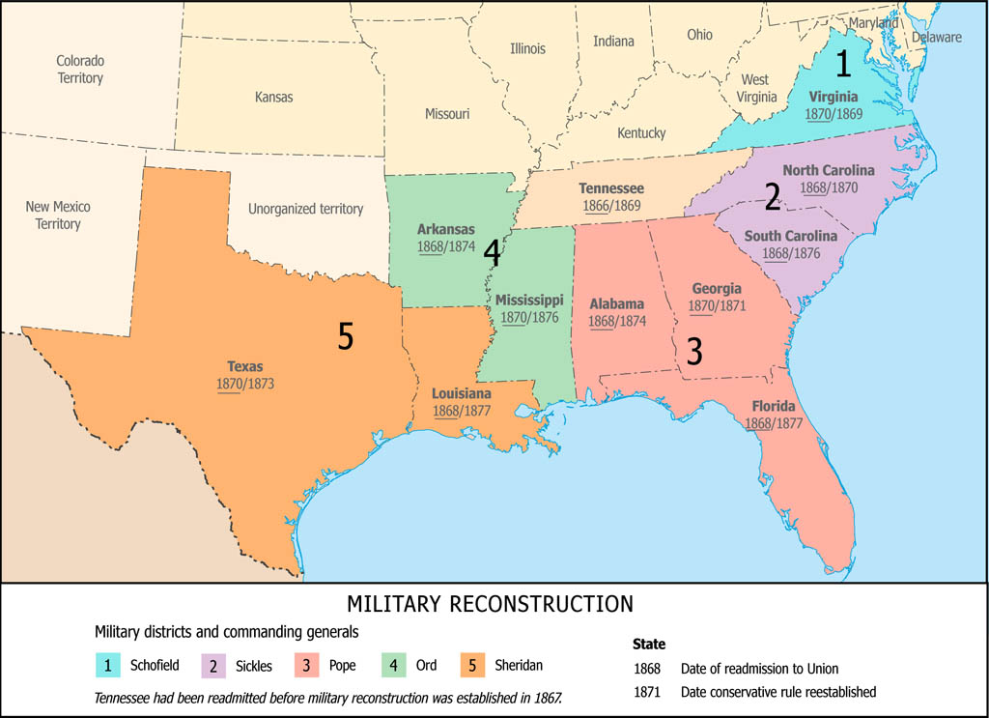
Radical Reconstruction
The Radical Republicans quickly divided the South into five military districts
Former Confederates leaders and politicians would not be able to hold political office
  Many northerners moved south to occupy open political positions, these people were called carpetbaggers.
Former Confederate states would not be readmitted to the Union until they ratified the 14th Amendment

Slide 29
Helping the Freedmen
During Reconstruction, the Radical Republicans tried to help the freed slaves become contributing members of southern society.
  The Freedman’s Bureau
    A government agency designed to help freed slaves learn to read and write
    Helped freed slaves buy small plots of land and tools so they could become independent farmers

Slide 30
The South Fights Back
The Black Codes
  As each Confederate state was readmitted, they passed laws to limit the civil rights of African Americans living within their state.
  Examples of the black codes:
    African Americans could not own weapons
    Race was defined by blood
    Interracial relationships were illegal
    Schools and public facilities were segregated

Slide 31
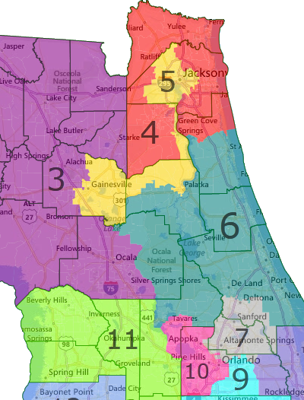
Dirty Politics
  Southern Democrats used two practices to exclude African Americans from voting
  Gerrymandering
    Changed voting districts to counteract African American votes
  Poll Taxes
    Made all voters pay a tax before voting (Most African Americans could not afford to vote)
  Literacy tests – African Americans had to pass an extremely difficult test to prove that they could read and write before they were able to vote.

Slide 32
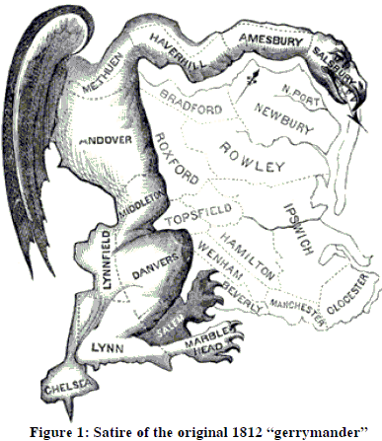
Gerrymandering

Slide 33
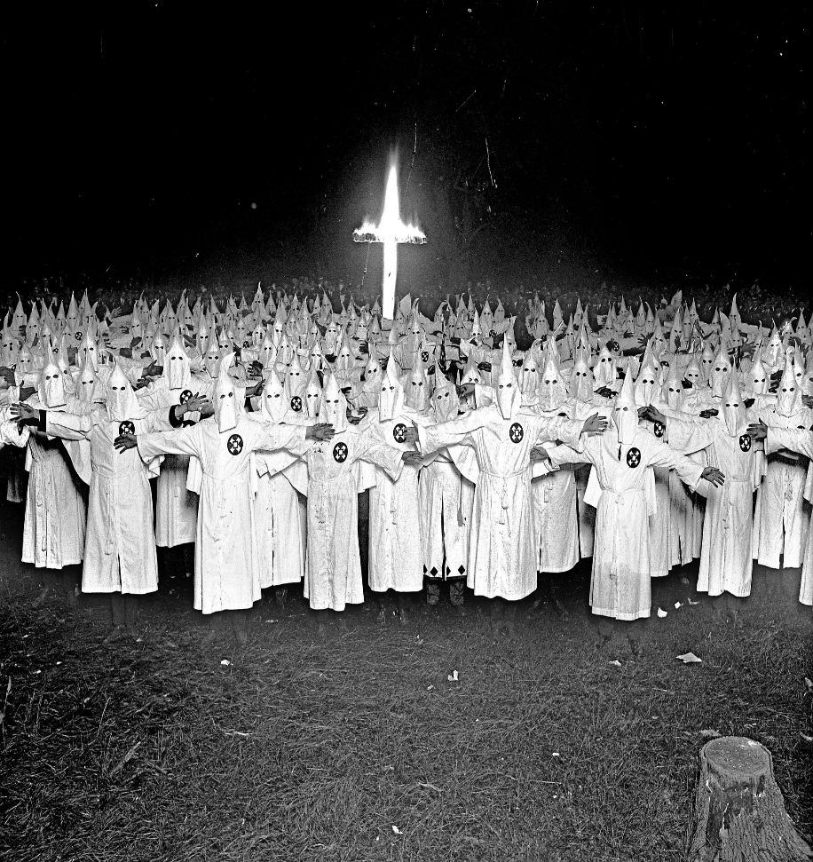
The Invisible Empire
Ku Klux Klan
  New White Supremacist group formed in the South
  terrorized newly freed African Americans
    Used intimidation and violence to prevent African Americans from exercising their voting rights

Slide 34
Sharecropping
Sharecropping – a farming system where African American farmers would rent land to farm and then have to pay a portion of their profits to the land owner
  This system prevented African Americans from owning land in the south and kept them in perpetual poverty.

Slide 35
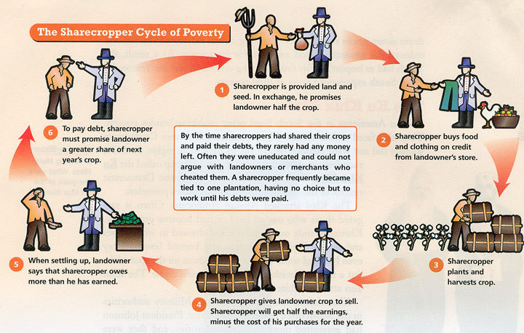
Sharecropping Cycle of Poverty

Slide 36
The Amnesty Act and the End of Reconstruction
1872 - Congress passed the Amnesty Act
  Gave the right to vote and hold political office back to former Confederates.
1877 – The North withdrew the military troops from the South and Reconstruction was officially ended.

