Slide 1
The Cold War Vocabulary
Satellite Nations Arms Race
Containment Black List
Limited War Brinkmanship
Censure Iron Curtain

Slide 2
The Cold War
Unit 9

Slide 3
United Nations
After WWII
The creation of the United Nations
A world peace keeping organization
The U.S. and the Soviet Union emerge as the two world superpowers

Slide 4
What is Communism?
Communism
A form of government that attempts to abolish:
social classes
private property
wage labor
political parties

Slide 5
The Iron Curtain
Winston Churchill
Gave the famous “Iron Curtain” speech
Iron Curtain
Symbol representing the division of eastern and western Europe.

Slide 6
The Truman Doctrine
President Harry Truman
The Truman Doctrine
The U.S. would come to the aid of any country trying to resist the Soviet Union’s communist influence
Containment
Trying to stop communism from spreading across Europe

Slide 7
Control in Eastern Europe
Joseph Stalin
begins to install communist satellite countries in Eastern Europe
Poland, Czechoslovakia, Hungary
The U.S. responds with the Marshall Plan

Slide 8
The Marshall Plan
Secretary of State George Marshall
Marshall Plan
The U.S. would spend 13 billion (over 5 years) to help Europe rebuild (Including the Soviet Union)
The plan weakened communism in Europe
Tensions with the USSR began to build

Slide 9
The Allies Form NATO
North Atlantic Treaty Organization (NATO)
(First U.S. military alliance since the Revolutionary War)
Allied the U.S. with 10 European countries
Netherlands, France, Britain etc…
If one country got attacked, they all went to war

Slide 10
The Soviets Respond
The Warsaw Pact
The Soviets version of NATO
Soviet alliance with Eastern European countries

Slide 11
Showdown in Berlin
Berlin, Germany
Split in half
U.S. and Britain controlled West Berlin (Democratic)
The Soviets controlled East Berlin (communist)

Slide 12
Stalin’s Blockade
Joseph Stalin
Stalin hoped to force the Americans to abandon their plans for Germany
Blockade on all roads, waterways, and railroads from East Berlin to West Berlin

Slide 13
The Result
Blockade Results
2,000,000 + West Berliners were now cutoff from the outside world
No food
No electricity
No Fuel

Slide 14
Airlift Saves Berlin
The Berlin Airlift
American and British planes landed every 3 minutes in W. Berlin
Delivered milk, potatoes, blankets, coal
After 11 months
277,000 total flights
2 million tons of supplies

Slide 15
The Result of the Airlifts
The Americans
Became heroes to the Germans
The Soviets
World opinion turned against the Soviets
Stalin’s blockade was a failure
Stalin lifted the blockade

Slide 16
THE KOREAN WAR

Slide 17
THE KOREAN WAR VOCABULARY
38TH Parallel
Korean War
Armistice
Limited War
Containment (As it pertains to a country)

Slide 18
PRE WWII
1910 Japan colonizes the Korean Peninsula
Korea’s king was exiled to Japan

Slide 19
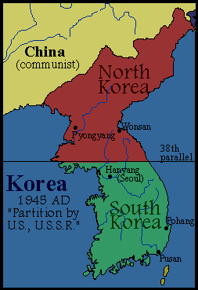
POST WWII
US establishes 38th parallel as the dividing line
Seoul and Inchon were south of this line otherwise this was an arbitrary line.
USSR in the north/ USA in the south

Slide 20
SOUTH KOREA
UN oversaw the elections in 1948.
Syngman Rhee elected as the 1st President

Slide 21
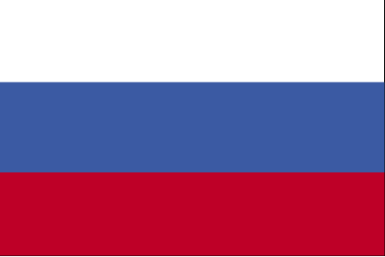
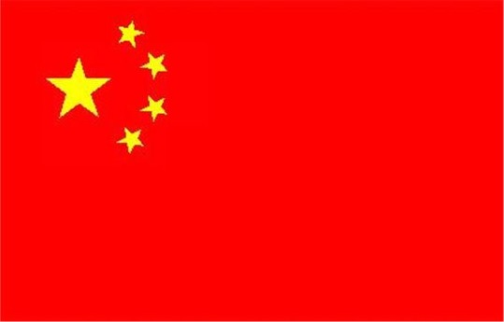
NORTH KOREA
The USSR and China supported North Korea
In June 1949 installed Kim Il Sung as the leader
Joseph Stalin had great influence and demanded that Kim Il Sung “Get down there”

Slide 22
WAR ERRUPTS
June 25, 1950 North Korea attacks into the south
The UN meets and denounces the attack
The UN votes to send military support to help South Korea
No USSR to veto
China chooses not to vote

Slide 23
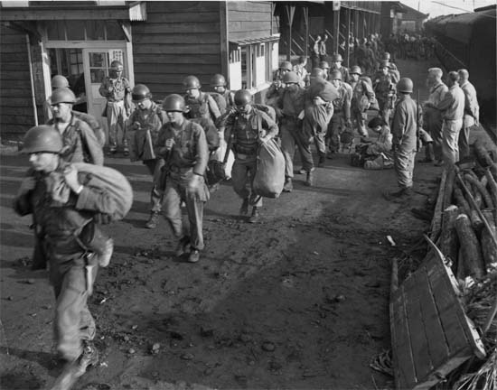
TASK FORCE SMITH

Slide 24
MacArthur “SAVES THE DAY”
GEN Douglas MacArthur led UN troops land at Inchon and recapture Seoul
Momentum leads to an expulsion of North Korea from the south
UN attack into the north
China warns UN to stop

Slide 25
CHINA ENTERS THE WAR
Using the cover of darkness China occupies North Korea
UN forces fail to heed China’s warning
China unleashes a six mile ambush

Slide 26
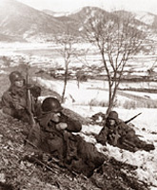
WAR REACHES A STALEMATE
GEN Matthew Ridgeway tells US forces “No more retreating.”
Troops take stand at Chipyong-ni
The war bogs down at the 38th parallel

Slide 27
THE WAR ENDS???
General Eisenhower runs for President and says he will end the Korean War
UN and North Korea sign an Armistice Agreement

Slide 28
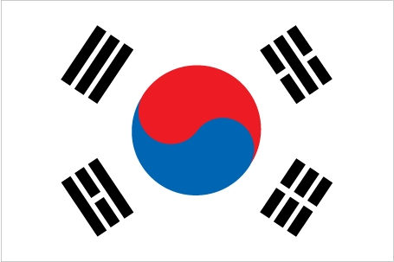
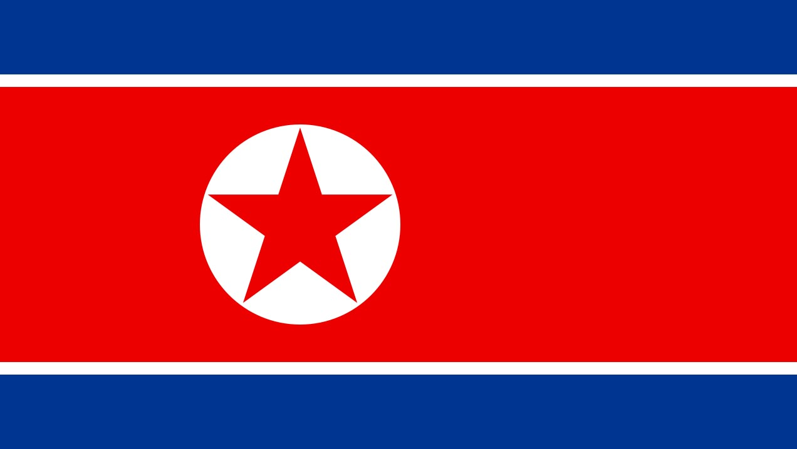
THE KOREAN WAR TODAY
Technically the Korean War is still waging
This was a limited war

Slide 29
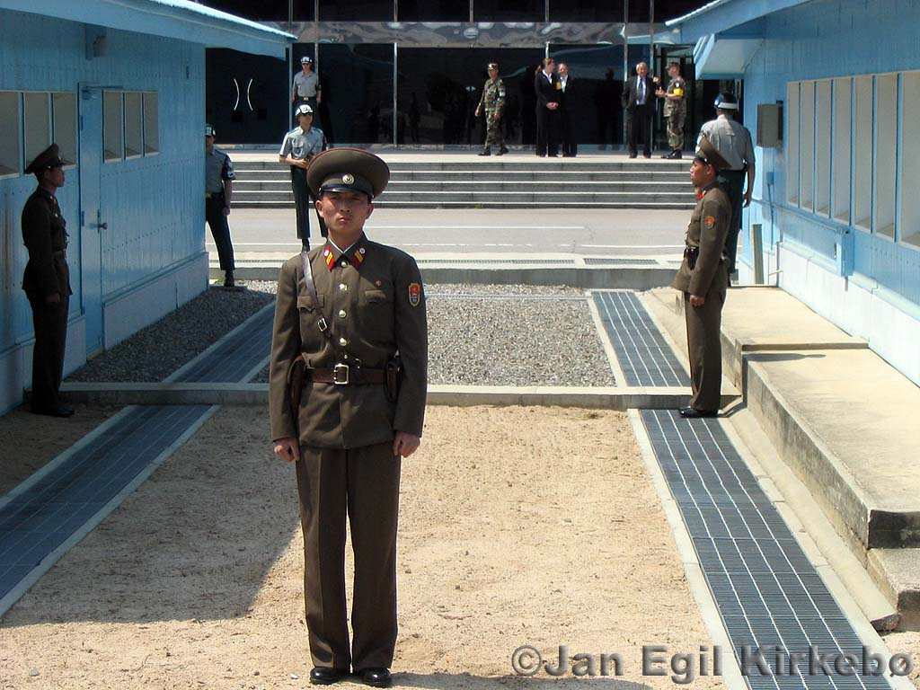
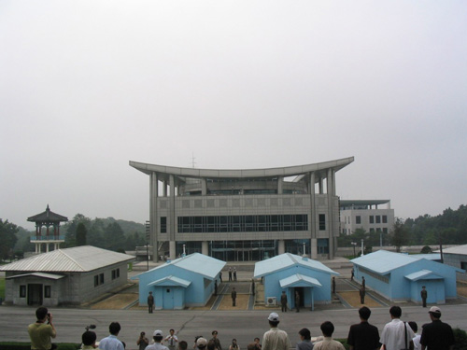
TWO NATIONS STILL AT WAR

Slide 30
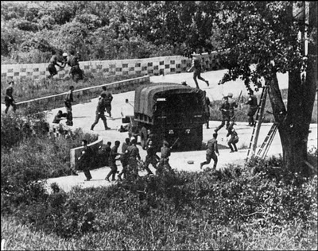

Slide 31
Two Nations Live on the Edge
Unit 9

Slide 32
McCarthyism In America
Senator Joseph McCarthy
Launched a communist witch hunt in America
Accused many high ranking government officials of being communist
Proved that fear of communism was getting out of control in America

Slide 33
GOOD NIGHT & GOOD LUCK: EDWARD MURROW SPEECH

Slide 34
Two Countries on the Edge of War
During the Cold War
The U.S. practiced a policy of brinkmanship
A policy of going to the edge of all-out war

Slide 35
Pledging Protection
The Eisenhower Doctrine
The U.S. would give financial or military aid to any middle-eastern country that requested it
Mainly to fight off
Soviet influence
Spread of communism

Slide 36
The CIA Joins the Fight
1947
Congress passes the National Security Act (Under Truman)
The CIA is born
CIA (Central Intelligence Agency)
Spied and performed covert operation
Used intelligence to counter Soviets moves

Slide 37
CIA Success
1949
The CIA is so successful, Congress gives them the right to spend unlimited money
They had to report the spending to no one except the CIA director

Slide 38
The Space Race Begins
Space Race
The U.S.-Soviet competition for supremacy of the earth’s orbit
The US creates NASA

Slide 39
Sputnik Ups the Stakes
1957
The Soviet Union launches a rocket carrying Sputnik
The world’s first orbiting satellite

Slide 40
Sputnik

Slide 41
Kennedy and the Cold War
Unit 9

Slide 42
1960 Election
1960 Presidential Election
John F. Kennedy vs. Richard Nixon
First time Television played a role in the election of the president

Slide 43
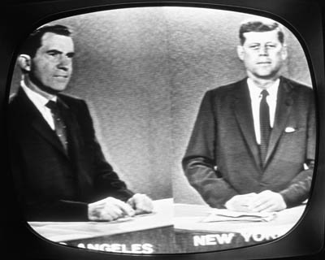
Kennedy vs. Nixon

Slide 44
Television’s Role in the Election
The first publicly televised presidential debate helped the public decide the presidency
Kennedy won the election because:
He was a better speaker
He was more handsome
He had a young family
He appointed his brother (Robert Kennedy) as his attorney General

Slide 45
Kennedy as President

Slide 46
Kennedy as President
PRESIDED OVER:
Bay of Pigs
Cuban Missile Crisis
Space Race
Civil Rights Movement

Slide 47
The Berlin Crisis
August 1961
The Soviet Union premier Nikita Khrushchev closed emigration from all Eastern Bloc countries (including East Germany)
Construction of the Berlin Wall begins
A wall separating East Berlin from West Berlin

Slide 48
Limited Test Ban Treaty
Limited Test Ban Treaty
Developed by Kennedy
Signed by leaders of “nuclear nations”
Banned the testing of nuclear weapons:
In the atmosphere
In outer space
In the water

Slide 49
Kennedy’s Flexible Response
Flexible Response
Stated that if the U.S. was attacked, it didn’t have to respond with nuclear weapons
Unlike Eisenhower’s massive retaliation, the U.S. could respond according to how they were attacked.

Slide 50
The Kennedy Assassination
Unit 9
Section 6

Slide 51
Running for Re-Election
1963
Kennedy is running for re-election in 1964
Because of JFK’s support of Civil Rights:
He loses a lot of support from the south
Travels to Dallas Texas to win back support from the key southern state

Slide 52
Driving Through Downtown Dallas
November 22, 1963
JFK set to give a speech downtown
His Motorcade included:
Governor Connolly from Texas
Jackie, his wife
JFK insisted on riding with the top down so the people could see him.

Slide 53
3 Shots that Changed the World
3 Shots ring out
As the motorcade passes through Dealey Plaza
The shots came from the 6th floor of the Dallas book depository

Slide 54
Kennedy Hit
The Three Shots
Shot One - passes through JFK’s neck area and into the side of Governor Connolly
Shot Two – Misses
Shot Three – Enters the back of Kennedy’s head and exits the front (fatal)

Slide 55
The Shooter
Lee Harvey Oswald
24 years old
Former Marine
Communist sympathizer
Arrested for shooting a Dallas cop 40 min after the assassination

Slide 56
Oswald Killed
2 days later
On National T.V.
While being transferred to the county jail Oswald is shot, and killed by Jack Ruby, a local strip club owner.
Jack Ruby dies in prison a couple years later

Slide 57
The Warren Commission
The Warren Commission
Established by Lyndon B. Johnson (JFK’s Vice President)
Designed to find the truth behind the assassination
Concluded that Lee Harvey Oswald acted alone in the killing of JFK

