Slide 1
The New Immigrants

Slide 2
Europeans
1870-1920
  20,000,000 Europeans came to America
  Came to New York
Reasons for coming to America:
  Famine
  Land Shortages
  Religious and Political persecution
Birds of passage- planned to come to America to make some money and then return to their homelands.

Slide 3
Chinese and Japanese
1851-1883
  500,000 Asian immigrants came to California
  Many came to try to find gold
  Many helped with the railroads
The Japanese flooded America with the annexation of Hawaii in 1898

Slide 4
The West Indies and Mexico
1880-1920
  260,000 immigrants came to the southeastern US
  Came from:
    Jamaica
    Puerto Rico
    Cuba
At one point 700,000 (1/7th) of Mexico’s population came to America

Slide 5
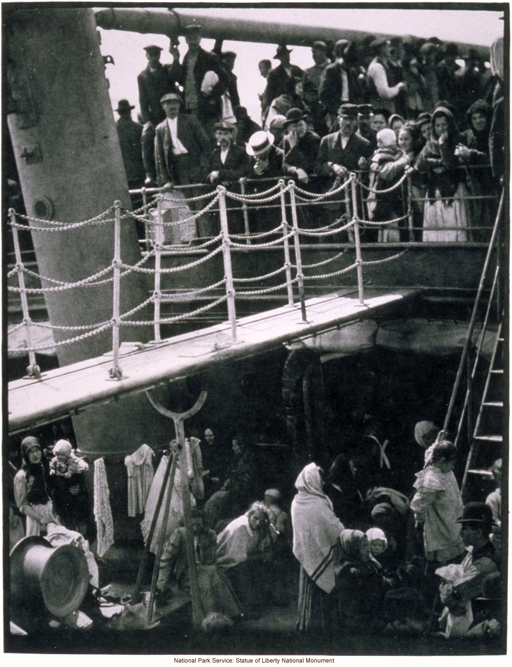
Difficult Journey
The immigrants came to America by steamships
  Across the Atlantic took one week
  Across the Pacific took three weeks
  Slept in lice infected beds on the trip
  Many caught disease and died

Slide 6
Life in the New Land
All immigrants to New York went through inspection at Ellis Island
It was not uncommon for immigrants to wait for over a day to be inspected.
To enter the US:
  They had to be disease free
  Never have been convicted of a felony
Immigrants on the west coast arrived in Angel Island in San Francisco Bay
1910-1940 500,000 Chinese entered the US from Angel Island
Ellis Island
Angel Island

Slide 7
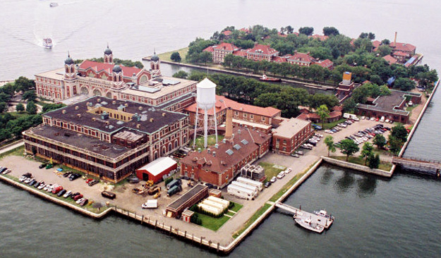
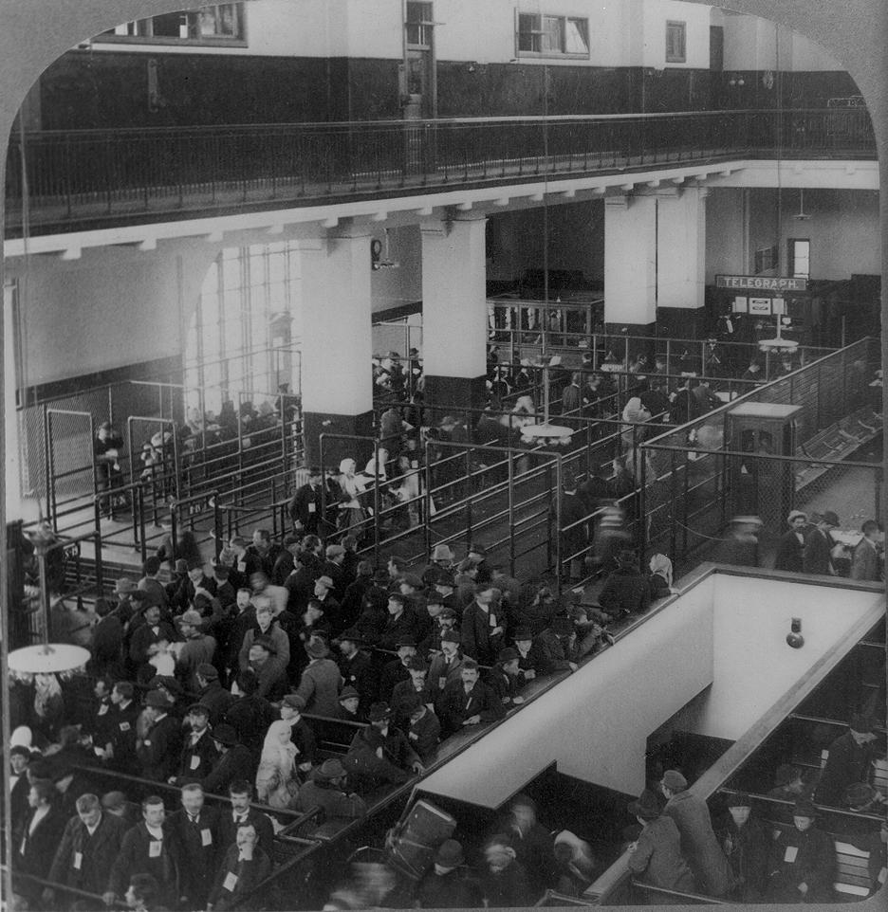
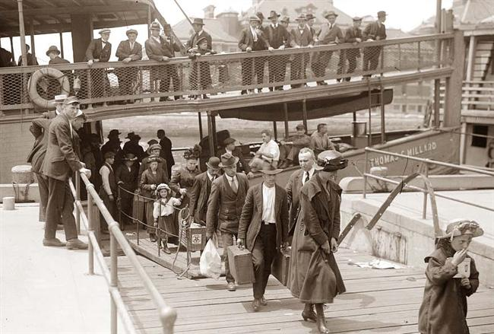
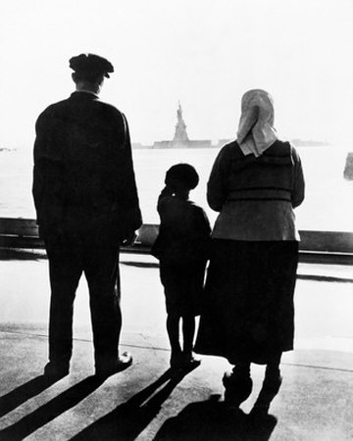

Slide 8
Immigrant Restrictions
Americans thought of the country as a melting pot, or people that had abandoned their country to become Americans
The new immigrants did not want to abandon their old culture:
  Strong opposition to immigrants grew
  Nativism- favoritism toward natural born Americans became more prominent

Slide 9
MYTH OF THE MELTING POT EXERCISE
In your group write an essay question. A person should be able to use this article and prior knowledge to develop their answer.
The question should be a higher order thinking type question.
An example question would be:

Slide 10
America was dubbed the melting pot, which you have already read was an unfitting title. Now that many prejudices have simmered down and Americans have had to unite during catastrophes such as 9-11 and Hurricane Katrina, do you think America is on its way to developing into a “melting pot” nation? Explain your answer. In what ways does the American culture differ from that of other countries? (Question submitted by Matt Guzman and Cheryl Helmintoller)

Slide 11
Immigrant Restrictions
Immigration Restriction League
  1894
  Founded by Prescott F. Hall
  Discriminated against Jews and Catholics
  Proposed a bill that would make all immigrants take a literacy test to be admitted into the country.

Slide 12
Chinese Exclusion Act
The anti- Chinese sentiment began when they began to work for lower wages than Americans had commonly demanded.
1882
  Congress passed the Chinese Exclusion Act
    All Chinese were banned from America except for students, teachers, merchants and government officials.

Slide 13
Gentleman’s Agreement
The Gentleman’s Agreement
  1907-1908
  Japan’s government agreed to limit emigration of unskilled workers for the repeal of the San Francisco segregation order.

Slide 14
CAUSE & EFFECT EXERCISE
Using your book (Ch. 7 Sec 1) create a cause and effect diagram for the following effects:
  Immigrants leave their home countries
  Immigrants face hardships in the United States
  Some nativists want to restrict immigration

Slide 15
The CHALLENGES OF urbanization

Slide 16
Setting the stage
Making a living in the late1800s and early 1900s
Famines hit farmers in Europe and the United States
The Urban population expanded from 10 million to 54 million between 1870 and 1920

Slide 17
Urban Opportunities
The technological boom in the early 1900s contributed to the United States’ growing industrial strength
  The result was rapid urbanization, or growth of the cities.
  Mostly in the Northeast and Midwest

Slide 18
Immigrants settle in Cities
Most of the immigrants during the late 19th century became city-dwellers.
Reasons
  Cities were the cheapest places to live
  Cities offered factory jobs to unskilled workers

Slide 19
Americanization Movement
Americanization
  Designed to help immigrant assimilate to the culture of the United States
  Provided immigrants with the necessary skills to live in America
    English literacy
    American History
    American Government
Despite this movement many immigrants did not want to give up their customs
Immigrants began to flock to neighborhoods where they could speak their own language and practice their own customs.

Slide 20
Migration from country to City
New farming inventions of the time period began to cost many African Americans their jobs.
  Many of them began to move to Chicago and Detroit to escape racial violence
  Segregation and discrimination still existed even in northern cities
  Job competition between black and white immigrants caused even further racial tension.

Slide 21
ENDEX

Slide 22
Urban Problems
Housing
  Row Houses- Single family housing that shared walls with similar houses
  Eventually these families moved out of the city and immigrants took over the row houses, often cramming 2-3 families in a single family house.
    These multi-family dwellings were known as tenements

Slide 23
Transportation and Water
Mass Transit
  Transportation design to move mass amounts of people from one place to another
  Enable workers to get to jobs more easily
    Street cars in San Francisco
    Electric Subways in New York and Boston
Water
  Supplying safe drinking water was also a challenge
  Public waterworks were in high demand
  Most places did not have indoor plumbing
    Resulted in disease such as typhoid fever and cholera

Slide 24
Sanitation
As cities grew so did the need for sanitization
  Horse Manure piled up on the street
  Sewage flowed in the gutters
  Factories spewed smoke into the air
  People dumped trash in the streets
By the 1900s many cities developed sewage lines and sanitation lines

Slide 25
Crime
As the population of cities increased so did crime
  Pick-pockets and thieves flourished
  Cities organized full-time police staffs to cut down on crime…
  …It did not help much
Fires
  1870-1880
    Almost every major American City suffered a big fire during this time
    The lack of water hurt the firemen trying to fight the blazes.
    Most Firemen were volunteers

Slide 26
The Settlement House Movement
Social Gospel Movement
  Preached salvation through service to the poor
  Inspired by this message, many people called for the helping of the poor
  The establishment of Settlement Houses begins
    Provided assistance in slum neighborhoods
    Run largely by middle class, college educated women
    Provided social and cultural education for poor people

Slide 27
WTL
What are the negative effects of a corrupt government? What is the best way to avoid this type of government in a free society like the USA.

Slide 28
Politics in the Gilded Age

Slide 29
Setting the Stage
Late 19th century
  Cities are growing rapidly
  Social Darwinism was at its peak
  The government was inefficient
  The people were receptive to a new form of politics.

Slide 30
The Political Machine
Political Machine
  An organized group that control the actions of a political party in a city
  Offered services to voters and businesses in exchange for political or financial support
  Gained power over cities like:
    Baltimore
    New York
    San Francisco
    Chicago

Slide 31
Political Machine Structure
City Boss
  Controlled the activities of the political party
Ward Bosses
  Tried to secure votes from people in all the precincts within a ward
  Did favors for the poor and elderly in an attempt to get their votes
Precinct Captains
  Tried to secure votes from certain city blocks and neighborhoods
  Reported to the Ward Bosses

Slide 32
CITY
WARD
WARD
WARD
WARD
WARD
WARD

Slide 33
Role of the Boss
Role of the boss
  Controlled access to municipal jobs
  Business licensing
  Gave money to schools and hospitals
  Built parks and sewer systems
Immigrants and the “Machine”
  Many 1st and second immigrants got involved in politics
  They started at the bottom and worked their way up
  They could speak to other immigrants in their own language in order to persuade voters

Slide 34
Election Fraud and Graft
When the loyalty of voters was not enough to win an election, politicians turned to fraud to win
  Voting multiple times under different names
Graft- Using politics for personal gain
  Politicians would take bribes from businesses in order for certain kickbacks

Slide 35
The tweed ring Scandal
William “Boss” Tweed
  Head of Tammany Hall- New York’s largest democratic political party
  Led a ring of corrupt politicians that defrauded the city
    Collected 13 million dollars in taxpayer money for a building that only cost 3 million.
  Eventually got indicted on 120 counts of fraud
Go to page 269 in your book: Analyze the political cartoon. What is its meaning?

Slide 36
Patronage Spurs Reform
Patronage- the giving of government jobs in exchange for political support
  “Don’t patronize me!!”
Reformers began to press for the elimination of patronage.
They believed that government jobs should be given to the most qualified person.

Slide 37
Reform
Presidents: Rutherford B. Hayes, James A. Garfield and Chester A. Arthur brought reform to patronage
  A history lesson on why James Garfield likely died
Pendleton Service Act of 1883
  Bipartisan civil service commission to make appointments to federal jobs
  Since politicians could no longer use jobs as bribes for support, they turn elsewhere…

Slide 38
Business Buys influence
With employees no longer the source for political support, politicians turned to business.
Businesses hoped for high tariffs to protect them from foreign competition.
  The democrats opposed high tariffs because they would increase prices
  Democrat, Grover Cleveland won the presidency, but congress did not support his plan to lower tariffs.

Slide 39
Business buys influence
Cleveland ran for re-election on the low tariff platform and lost to Benjamin Harrison
Benjamin Harrison
  Increased tariffs to the highest level yet by passing the McKinley Tariff
Grover Cleveland
  Re-won presidency after Harrison’s term
  The only president to serve two non-consecutive terms.

