Slide 1
The Expansion of Industry

Slide 2
Setting the Stage
In the years following the Civil War the U.S. was still largely agricultural
By the 1920s the U.S. had become one of the largest industrial powerhouses in the world
The US had:
An abundance of natural resources
Government support for large industry
A growing urban population

Slide 3
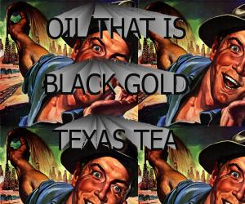
Black Gold
1859
Edwin Drake
Used a steam engine to drill for oil near Titusville, PA.
Started an oil boom in many states
Kerosene was originally refined from oil for burning lamps
After the introduction of the automobile, gasoline became the most important form of oil.

Slide 4
Bessemer Steel Process
Henry Bessemer
Developed the Bessemer steel process
Injected air into iron to remove the carbon and other impurities
This process turned iron into steel
More flexible
Lighter
Rust resistant

Slide 5
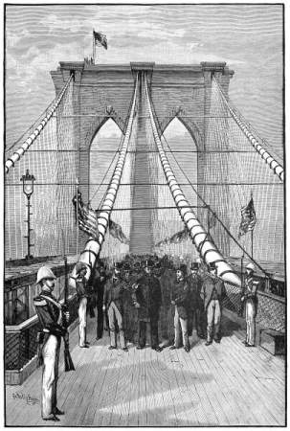
New Uses for Steel
The railroads became the biggest customer for steel
The Brooklyn Bridge
100% Steel
1883
1595 feet across the East River in NY
William Le Baron Jenny
Designed the first skyscraper (Home Insurance Building- Chicago)
Built with a steel frame

Slide 6
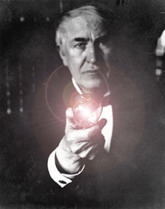
The Power of Electricity
Thomas Edison
1883
Perfected and patented the incandescent light bulb
Later invented the entire process for producing and distributing electricity
Uses of electricity
Industrial machines
Lighting for factories
Factories could now be located wherever

Slide 7
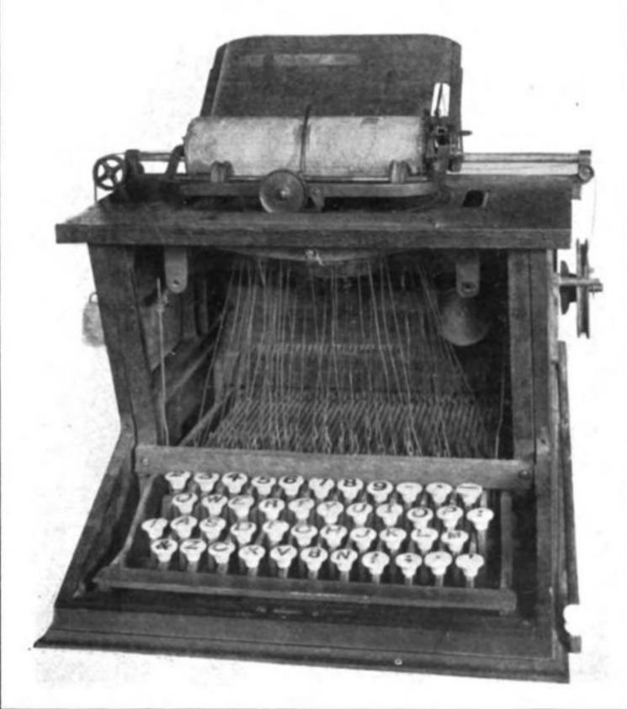
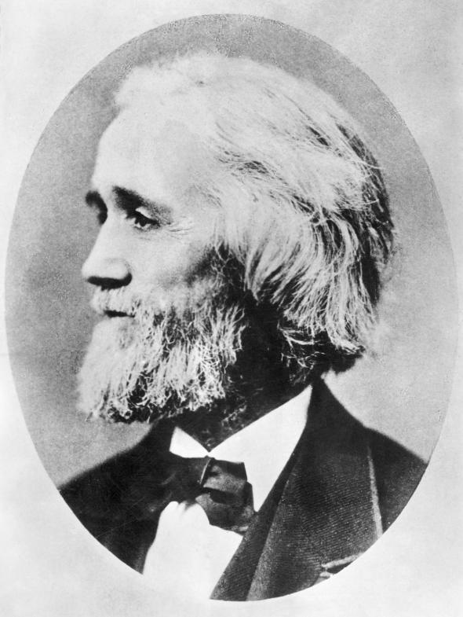
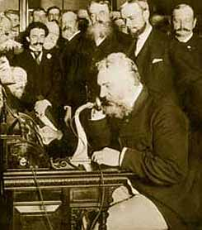
Inventions Change Lifestyles
Christopher Sholes
Invented the typewriter in 1867
Alexander Graham Bell
Invented the telephone
The most important invention next to the light bulb

Slide 8
Women At Work
These inventions allowed for greater amounts of office jobs…
…This opened up more jobs for women
1870- 5% of office workers were women
1910- 40% of office workers were women

Slide 9
DISCUSSION STARTER
Are we still in the middle of the Industrial Age today? Why or Why not?

Slide 10
The Age of the Railroads

Slide 11
Railroads Span Time and Space
By 1856 the railroads made it just west of the Mississippi.
Central Pacific Railroad and Union Pacific first transcontinental railroad came together at Promontory, Utah.
The two railroads were connected with a golden spike.

Slide 12
Romance and Reality
With the railroad came:
A new start
New land
New Opportunity
Central Pacific Railroad was built by Chinese immigrants
Union Pacific was built by Irish immigrants
Over 2000 people died and 20,000 more were injured connecting these two railroads

Slide 13
Railroad Time
The transcontinental railroad brought America back to one united nation
Noon was considered when the sun was directly overhead, but this was a different time in different places in the U.S.
C.F. Dowd
Proposed that the earth should be broken into 24 time zones
Four different time zones in the U.S.

Slide 14
As a result of the railroad:
Glass, Iron, Coal, Steel and Lumber industries grew rapidly
Towns began to spring up in the west
Population spread quickly westward
George M. Pullman
Built a factory for making railroad cars

Slide 15
The Grangers
Grangers
A group of farmers that demanded governmental control over the railroad
These laws would regulate railroads for the benefit of farmers and consumers
The railroad companies brought this to court
Munn v. Illinois
Supreme Court Case that upheld the “Granger Laws”

Slide 16
Interstate Commerce Act
1866
The Supreme Court ruled that states could not set rates on interstate commerce
Congress passes the Interstate Commerce Act
Gave the federal government the right to control commerce between states

Slide 17
3-2-1
3—Write three inventors/inventions we have discussed
2—Write why these inventions were important or necessary.
1—Write one thing you and your group learned today.

Slide 18
Big Business and Labor

Slide 19
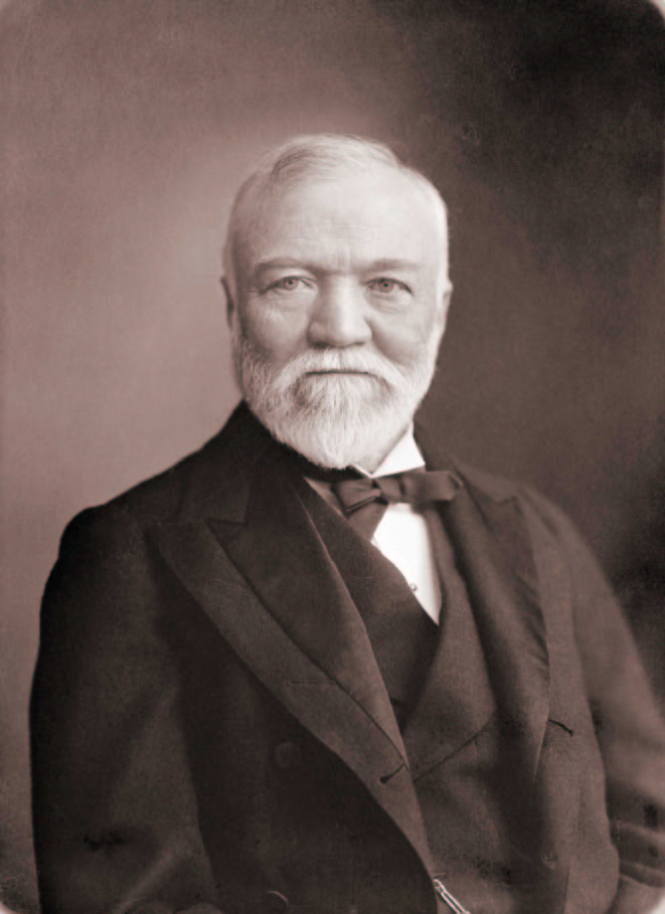
Andrew Carnegie
Carnegie
Poor Scottish immigrant
Worked for and bought stock in the Pennsylvania Railroad
Became rich from the investment
Carnegie Steel
Carnegie used the money from the investment to start a steel company.

Slide 20
Carnegie’s Success
New Business Strategies
Continually searched for a way to find better products more cheaply
Used accounting to track costs precisely
Attracted talented people by offering them stock in the company
Tried to own most of the steel market
Vertical Integration- bought all aspects of the industry: coal mines, railroad freighters etc.
Horizontal Integration- bought out all of his competitors

Slide 21
Social Darwinism
Social Darwinism
Grew from Charles Darwin’s theory of biological evolution
Darwin's theory was based on the natural selection (the strongest survive)
Social Darwinism refers to the natural selection of businesses (the strongest survive)
It was determined that government had no right to regulate business

Slide 22
Types of Businesses
Monopolies- Complete control over an industries products, wages, and prices.
Holding Companies- A corporation that does nothing but buy all the stock of another company
Trust Company- Companies that turned their stock over to other companies who then ran both companies as one large organization.

Slide 23
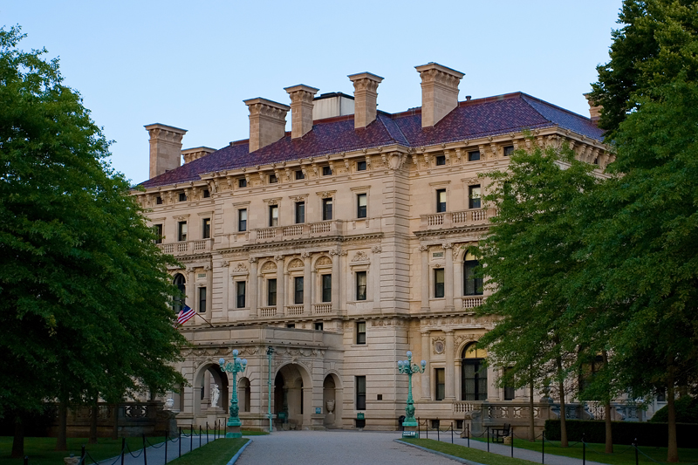
Monopolies
The goal of business was to own all aspects of the business and achieve monopoly
JP Morgan
Banker that owned US Steel
Bought out Carnegie Steel
US Steel became the biggest US business
John D. Rockefellar
Standard Oil owner

Slide 24
Sherman Antitrust Act
The government was concerned that these new monopolies were ruining free competition
Sherman Antitrust of 1890
Made it illegal to form a trust that interfered with trade between states or other countries
The companies that had merged had to reorganize into single businesses again
Made it illegal for business to own all aspects of an industry

Slide 25
Labor Unions
The growth of business brought about the need to labor unions
It was not uncommon for factory worker to work 12 hour days 6 days a week (72 hours a week)
Kids as young as 5 were working 12 hour days for 27 cents a day

Slide 26
Union Movement Diverge
The American Federation of Labor
Samuel Gompers- President
Focused on negotiations between management and labor unions
Used strikes as a major tactic
Strikes helped the union win higher wages and shorter work weeks

Slide 27
Socialism
Socialism- belief in governmental control of business and property as well as the distribution of the wealth
Comes from the ideas of the German Philosopher Karl Marx
Wanted to overthrow capitalism
Socialism at its extreme form is known as communism

Slide 28
Strikes
The Great Strike of 1877
Baltimore and Ohio Railroad (B&O)
Protesting the second wage cut in 2 months
President Rutherford B. Hayes stepped in and put a stop to the strike because it was affecting interstate commerce.
Other major strikes
The Haymarket Affair
The Homestead strike
Pullman company strike

